Slide 1
TIBCO Cloud Workshop
December 10th 2019

Slide 2
Agenda & Timings
Time | Length | Subject | Presenter
12:00 | 1 Hour | Registration, Networking & Lunch | All
13:00 | 15 Minutes | Welcome & Introduction to the team | Guy Murphy/Martyn Bedford
13:15 | 30 Minutes | Driving agile innovation across the Enterprise with the TIBCO Cloud Platform and our Event Based and API-led connectivity capabilities: Opportunities, challenges of connectivity and integration in today’s reality | Rishi Palve, Guy Murphy/Martyn Bedford
13:45 | 2 Hours | Hands-on Labs | Dave Winstone, Mark Mussett, Bryn Garton
 |  | Experiencing the full Event Based, API-led connectivity lifecycle
 |  | Designing an API & Creating a Mock Application
 |  | Implement and Test your API in the TIBCO Cloud with CI/CD
15:00 | 10 Minutes | Break
 |  | Event Driven Contextual Offers
 |  | Insights via Real-time Visual Cloud Analytics
15:45 | 1 Hour 15 Minutes | Open Discussion or Breakout rooms, adopting TIBCO Cloud, real-life examples including Low Code, FaaS, Streaming, Open Source Innovation, Citizen Integrator/Developer | Led by Guy/Martyn
17:00 | - | Close – Networking Reception, Refreshments, the TIBCO F1 Simulator Experience | All – in the Atrium

Slide 3




The important stuff
Wi-Fi
Username: Tibco_Guest
Password: Visitor100

Slide 4


25 year veteran of the industry, I have worked in every major sector with some focuses on Telco, Banking and Retail/CPG. I've spent the last decade acting as a Strategic Architect supporting both vendor sales teams and clients in various dimensions of digital transformation, from legacy SAP strategies adopting SOA and mobile to some of the most advanced API, hybrid strategies that have deployed agile/multi-modal operating models that have been the bench marks for Gartner and other analysts when defining industry trends. Also acted as an internal change agent on developing product, sales and marketing strategies. Can often be seen traveling the world with a Digital Camera.
Guy Murphy
Principle Digital Advisor

Slide 5

I am a Senior Product Manager at TIBCO. I have over 9 years of experience working in various roles across different groups such as P&T, Customer Engineering, PreSales and Product Management.
I take keen interest in APIs, Microservices, Event-driven architectures and Cloud-Native ecosystem. At TIBCO, I am responsible for building product roadmap and vision for our Cloud-Native, Event-driven product capabilities that are part of the TIBCO Connected Intelligence platform.
Rishikesh Palve
Senior Product Manager

Slide 6

I have had the benefit of working for TIBCO for the last 14 years, and that has allowed me to work with a wide variety of customers – from the largest Banks and Telco’s in the world, to the smallest innovators and disruptors.
I specialise in our “Connect” portfolio, allowing me to work with our customers on ensuring the right solutions and architectures are employed to provide the base for Digital Transformation.
Dave Winstone
Senior Presales Consultant

Slide 7

Veteran IT specialist with a career spanning 21 years in the Integration industry. Joined TIBCO in 2005, with 11 years in Professional Services as Technical Architect and 3 years in Pre-Sales organisations working with our Connected portfolio of products.
Expertise in API (Mashery), Integration (BusinessWorks, Flogo), Messaging (JMS, FTL, and RV), and Golang programming.
Mark Mussett
Senior Solutions Consultant

Slide 8
EAI, Distributed Systems, Java, TIBCO, Oracle Fusion Middleware, BPMN, BPM, BPEL, STP, Workflow, JavaSpaces, BAM, BI, Operational Risk Management.
Martyn Bedford
Senior Solutions Consultant

Slide 9

…
Bryn Garton
Senior Solutions Consultant

Slide 10
Customer Challenge
How Do You Create & Accelerate Value in the Digital World
TIBCO’s Value To Our Customers
Delivering Connected Intelligence through our Digital Business Platform
Notes:
Good morning / afternoon. I’m here today to discuss with you two key things (1) – What is the customer challenge, what’s happening out there in the business world? What are the trends & challenges? And (2) – how is Tibco relevant in relation to this and importantly to yourselves. What VALUE do we bring – this is where our strategy & vision will be discussed.
So lets firstly talk about what we see happening today, outside in business. The business boundaries are blurring, we see ..
Software is changing and driving the world we live in, its being used as the innovation multi-plier … Back in 2011 Marc Andressen (original founder of Netscape browser and owner of venture capital firm Andreessen Horowitz.) was quoted famously as saying “software is eating the world”… today in 2019 and looking forward into 2035, we see a new trend on the horizon and we are in no doubt software has changed the world we live in – referred to as “Hyper Acceleration Wave” where Artificial Intelligence is seen as eating software. Due to the

Slide 11
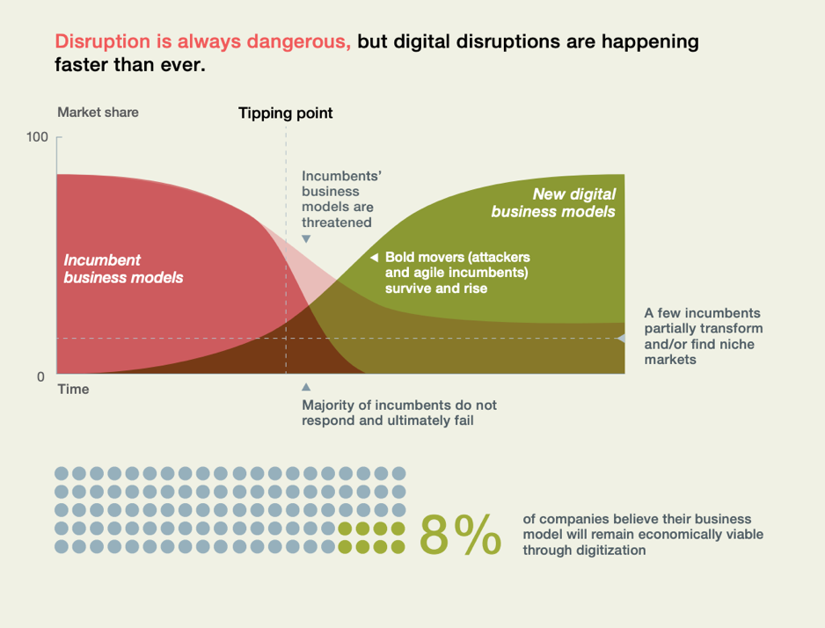
Digital disruption is happening faster than ever
Incumbent Models are under attack
Agile Movers Survive & Rise
New Models Created
<8% believe “their biz model will remain eco viable through digitalization”
McKinsey Report available at https://www.mckinsey.com/~/media/McKinsey/Business%20Functions/McKinsey%20Digital/Our%20Insights/Why%20digital%20strategies%20fail/Why-digital-strategies-fail.ashx

Slide 12
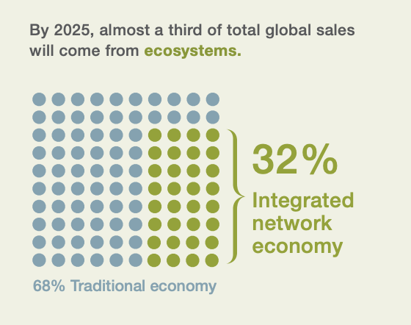
Digital disrupts = Companies need to change how they work & play.. Ecosystems
Platforms facilitate Ecosystem Business Models
= Business Value
= Agility
Businesses must be Open, API(s) will create the new models assisting new models & opportunities

Slide 13



How Are Tibco’s Customers Innovating for the Connected Intelligence Era?
$600,000
Anticipated OR cost savings PA
60%
Saving of time compared with previous technologies used
6 Years
Time to deliver own visualizations vs. 2 months
“In real time, we are able to alert our rapid response team to go to the bedside of a patient who is likely to go into cardiac arrest. So far, we’ve successfully reduced the number of cardiac arrests in the hospital by an estimated 15 to 20%.”
Chief Enterprise Architect, Christine Watts
Use Case
Integrated systems and centralized data to more effectively measure services and predict risks
"The software's ability to cover the full data science development lifecycle: data retrieval, preparation, transformation, analysis, and final interactive dashboard presentation, meant it could easily meet the aspirations of our proposed agile informatics process," Informatics Head of Unit SEPA, Mark Hallard
Use Case
Evidence-based decisions and efficient and automated analytics
The driver changes gears about 100 times a lap. Every time there’s a gear change, we collect around 1,000 data points. Those gear changes can be categorized into how fast they were, and how much stress they put on the gears. When you visualize that data, you can actually make the gear box last longer, or more importantly, make harsher gear changes. You can then find that if you put the gear box into one particular mode, it’s roughly 50 milliseconds faster per lap. Cars that were fourth and fifth in qualifying were one one-thousandth of a second different, so 50 milliseconds matters. So for us to be able to make those harsher gear changes is important. We spent six years creating our own visualizations. TIBCO turned up, and in a matter of two months, did better work.” Head of IT, Matt Harris
Use Case
Real Time Car Dynamics Changing, Continuous Improvement
Notes:
Firstly lets start with the definition , so we are all on the same page - what is an Connected Intelligent Organisation?
Proof points on customers:
SEPA - https://www.computerworld.com/article/3433261/scottish-environment-agency-unlocks-value-of-data-with-tibco-software.html

Slide 14





Our Value: The Digital Business Platform
Only TIBCO can guarantee its customers digital sovereignty by providing:
Comprehensive Platform
Accelerated Innovation
Freedom
Capabilities for Digital Execution | Simplification, Automation & Agility | Choice & Scale
Innovate and collaborate without constraints | Deploying anywhere and everywhere at pace | Operational Excellence From experimentation to mission critical
Notes:
TIBCO has one mission: enable digital transformation. But it does it in a unique way, that guarantees for its customers:
They remain in control of their data
They drive their own conclusion from the data, without bias
They are not constrained in the direction or speed of their innovation
In other words, they are digitally sovereign.
TIBCO guarantees this digital sovereignty with three elements:
Comprehensive Platform. TIBCO does not sell applications. TIBCO does not sell cloud workloads. TIBCO sells only one thing: a digital business platform with the capabilities to support your Digital Journey
Accelerated Innovation. TIBCO is agnostic to technologies to keep customer possibilities as broad as possible. TIBCO connects to any data, any technology.
Freedom. TIBCO’s platform is open by design. Our core capabilities are available as open source technologies (messaging, integration, analytics). All our components are open so that customers and partners can extend them. This vast community accelerates innovation, for the benefit of all of our customers!

Slide 15
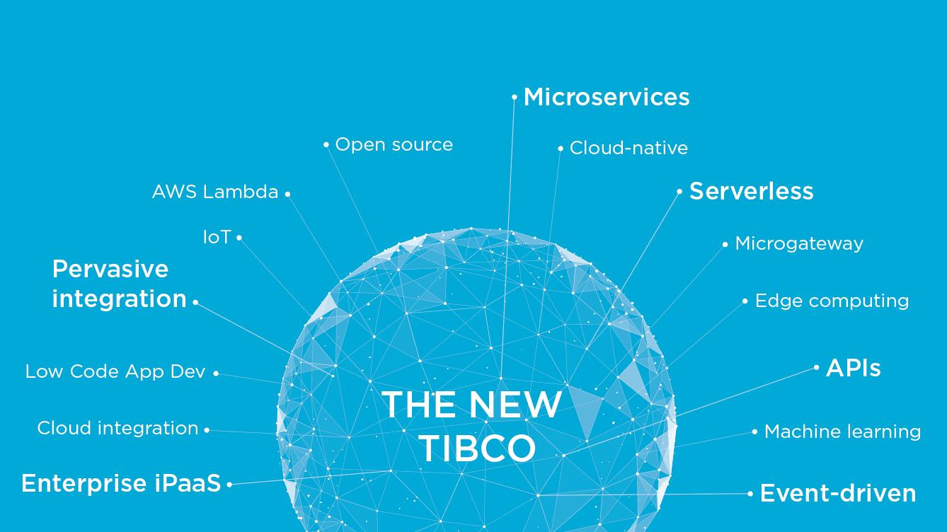
Digital is Built On This Foundation..

Slide 16

Best-In-Class, Open and Independent
AUGMENT INTELLIGENCE
Visual Analytics
Streaming
Data Science
Streaming BI
Messaging
Data Asset management
Integration
Data Preparation
CONNECT
EVERYTHING
UNIFY INFORMATION
Events
Data Virtualization
API Management
Compute Data Fabric

Slide 17



How TIBCO delivers the Connected Intelligence Vision
UNIFY
AI
Artificial Intelligence
VAn
Visual Analytics
SDa
Shared Data Assets
DS
Data Science
AUGMENT
EAn
Embedded Analytics
DV
Data Virtualization
Co
ComputeDB
SAn
Streaming Analytics
ERe
Enterprise Reporting
LCa
Low Code Apps
MSc
Microservices
Gr
GraphDB
Edg
Edge Apps
BPM
Business Process
AIn
Application Integration
iPa
Cloud Integration
EPs
Event Processing
API
Management
MSg
Messaging
Cloud
Native
Open
Platform
AI
Foundation
CONNECT
Notes:
Today, with the TIBCO Intelligence Cloud, we have a comprehensive digital business platform.
Different user personas: developers, analysts and end users Scribe fully integrated Connect and assemble: By connecting existing technologies with new technologies to create new services to enrich the customer experience with the best that you and your ecosystem have to offer to present data as a product, your business can now be fast and to scale connect and assemble. This is how ideas become innovations! Learn and adapt: ​​The data your business has access to today is a gold mine to understand the signals that power your business. Data Science and Analytics enable your business to continually learn and adapt quickly. This identifies potential innovations and measures their value! Sense and respond: The algorithm revealed by the learning and adaptive abilities can be used meaningfully to understand a positive or negative context and respond to it at the moment. This allows your company to recognize immediately and respond appropriately. In this way, innovations transform customer experiences or processes!
Unify Is a set of capabilities that enable organizations to provide timely and secure access to accurate, and consistent data required to drive business processes in operations, analytics, and governance.

Slide 18



Built on Strong Core Principles
 | Re-architected core capabilities as cloud-native ‘engines’ Deliver the same core cloud-native components across workloads Significantly reduced or removed any proprietary dependencies Devops/Cloudops/Dataops support delivered as open source
 | Provide customers the same tools used internally to extend capabilities Open source delivery of new key capabilities like Project Flogo Continued adoption of enterprise and emerging open source (e.g. Kafka) Increasingly active engineering participation in larger scale OSS projects
 | Application of AI principles and technology across capabilities to enhance workflow and user productivity Integration to leading AI frameworks both for real-time projects (Flogo with TensorFlow) as well as Data Science modeling and design Increasing use of AI as a platform for developing new capabilities such as adaptive business logic and execution
Cloud Native
AUGMENT
Open Platform
CONNECT
UNIFY
AI Foundation
© Copyright 2000-2019 TIBCO Software Inc.

Slide 19


Market Leadership Across The Platform
VISIONARY
LEADER
LEADER
AI
Artificial Intelligence
LEADER
LEADER
VAn
Visual Analytics
ML
Machine Learning
DS
Data Science
LEADER
AUGMENT
UNIFY
EAn
Embedded Analytics
DV
Data
Virtualization
CD
ComputeDB
SAn
Streaming Analytics
ERe
Enterprise Reporting
LCa
Low Code Apps
SDA
Shared Data Assets
Gr
Graph DB
IoT
Internet of Things
BPM
Business Processes
Edg
Edge Apps
HIn
Hybrid Integration
EPs
Events Processing
MSg
Messaging
API
Management
CONNECT
Marketshare
LEADER
Marketshare
LEADER
LEADER
LEADER

Slide 20




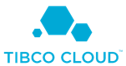










Available anywhere, everywhere
TIBCO Connected Intelligence
Devices
Open Source Give developers easy access to core capabilities of the Connected Intelligence Cloud
SaaS Quickly get up and running with a fully TIBCO hosted and managed service
Hybrid With all options for self-host, multi-cloud, or edge deployments
Dynamic Cloud Optimize cost by dynamically scaling on cloud infrastructure such as Amazon Web Services
Function
as a Service
On-premises
marketplaces proposing
TIBCO Cloud services
Notes:
And soon it will be time to scale these ideas. That’s where the Connected Intelligence Cloud differentiates again by allowing you to deploy your applications anywhere and everywhere from AWS (or your infrastructure of choice). The Connected Intelligence Cloud can fit in your current and future architectures thanks to private cloud or hybrid deployment. Connected Intelligence Cloud components can be:
Used as a service
Deployed in a hybrid architecture hosted both on premises and in the cloud.
And in some cases, can even be embedded in devices
You can adapt the Connected Intelligence Cloud to the cloud architecture your business requires. And when the context changes, you can adapt quickly. The flexibility of Connected Intelligence Cloud deployment allows businesses to constantly adapt their infrastructure to the business context, to deploy what matters where it’s needed while knowing exactly how much it will cost. The availability, the performance, as well as the cost efficiency of your digital initiatives is guaranteed by the Connected Intelligence Cloud.

Slide 21




The BiModal approach to API development
+
+
Newer
Workloads
[Mode 2]
Systems of Innovation
Speed & Agility
Traditional
Workloads
[Mode 1]
Change
Systems of Differentiation
Governance
Business
Analyst
Safety & Accuracy
Systems of Record
Integration Specialist
_
_
Notes:
This is the Gartner Bi-modal architecture. TIBCO supports this!!! We offer a iPaaS platform that can work with Mode 1 and Mode 2 scenarios. Mode 1 supports system API - these require a IT integration specialist to construct while mode 2 are API and features that change rapidly and can be more focused at department level work loads - TIBCO supports this. This type of architecture supports agility, speed and reuse. At the same time breaks the bottle neck of traditional IT work load. More employees can now participate in API development. Lets look at a use case.

Slide 22
The BiModal approach to API development APIs for Differentiation and Innovation
+
+
/offers
Systems of Innovation
Change
/itineraries
Systems of Differentiation
Governance
/passengers
/reservations
/flights
/gates
/retailers
Systems of Record
_
Airline Reservation System
Air Traffic Control
System
Airport Operations
System
Airport Retail
System
_
Notes:
This is the Gartner Bi-modal architecture. TIBCO supports this!!! We offer a iPaaS platform that can work with Mode 1 and Mode 2 scenarios. Mode 1 supports system API - these require a IT integration specialist to construct while mode 2 are API and features that change rapidly and can be more focused at department level work loads - TIBCO supports this. This type of architecture supports agility, speed and reuse. At the same time breaks the bottle neck of traditional IT work load. More employees can now participate in API development. Lets look at a use case.

Slide 23


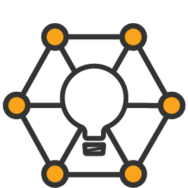
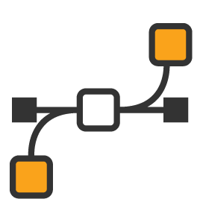
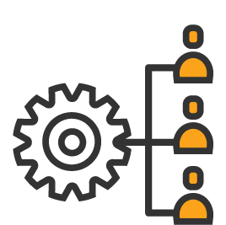


API-Led Strategy Is the Connective Tissue of Digital Business
App Dev & Integration
Digital Business Platform
Internal Agility
Standardize services
Channel
Expansion
New Distribution
Cloud-native
Microservices &
microgateways
B2B & B2C
Innovation
Partner Collaboration
API Platform
Integration
SaaS and
Hybrid Services
Enterprise Data, Services, and Applications
New Business
Models
Becoming an ecosystem platform
Notes:
The key use cases of an API Platform are bi-furcated but highly connected
Your API or integration Architect persona is focused on developing and integrating api-led services and enterprise apps at scale
An API Product Manager might sit within the LOB with a revenue or attainment goal, focused on turning enterprise services into digital platform for external partners or developers to build on
These users might even work for the same company, managing APIs in different ways, but often the services and apps overlap, and should be managed as such, through a single pane of glass

Slide 24




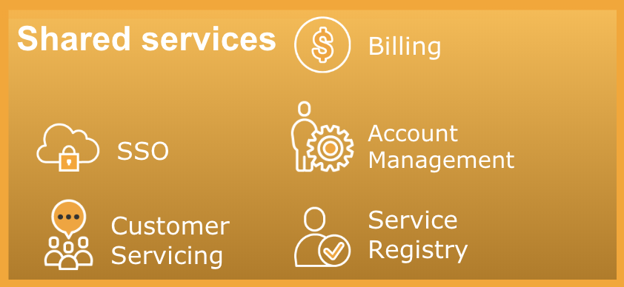





TIBCO Connected Intelligence Cloud
Capabilities
Data
Management
Advanced Data
Visualization
Streaming
Analytics
Integration and
API Management
Messaging and
Events Processing
Digital Process
Automation
Platform
Notes:
The capabilities of the Connected Intelligence Cloud can be grouped in 2 domains:
Interconnect Everything, and everyone. Any data, any system, any device, any technology can be connected and leveraged in applications, processes, or APIs. Put differently, we connect stuff and create smart applications. We provide the ideal set of capabilities to drive innovative initiatives around blockchain and IoT.
Augment Intelligence, with a set of analytics capabilities that range from a visual way to understand and consume data, to the ability to understand and act in real time with streaming analytics, to even the ability to power applications with analytics. We provide the ideal set of capabilities to leverage data science in the enterprise to make the business smarter with Machine Learning and Artificial Intelligence.
All of those capabilities are available via in the same platform, so businesses can start with what they need to address initial use cases with the confidence that they will be able to scale and expand as they need. This ability to adopt capabilities gradually is essential to innovation because it allows testing new ideas quickly, and scaling them when they’re good.

Slide 25
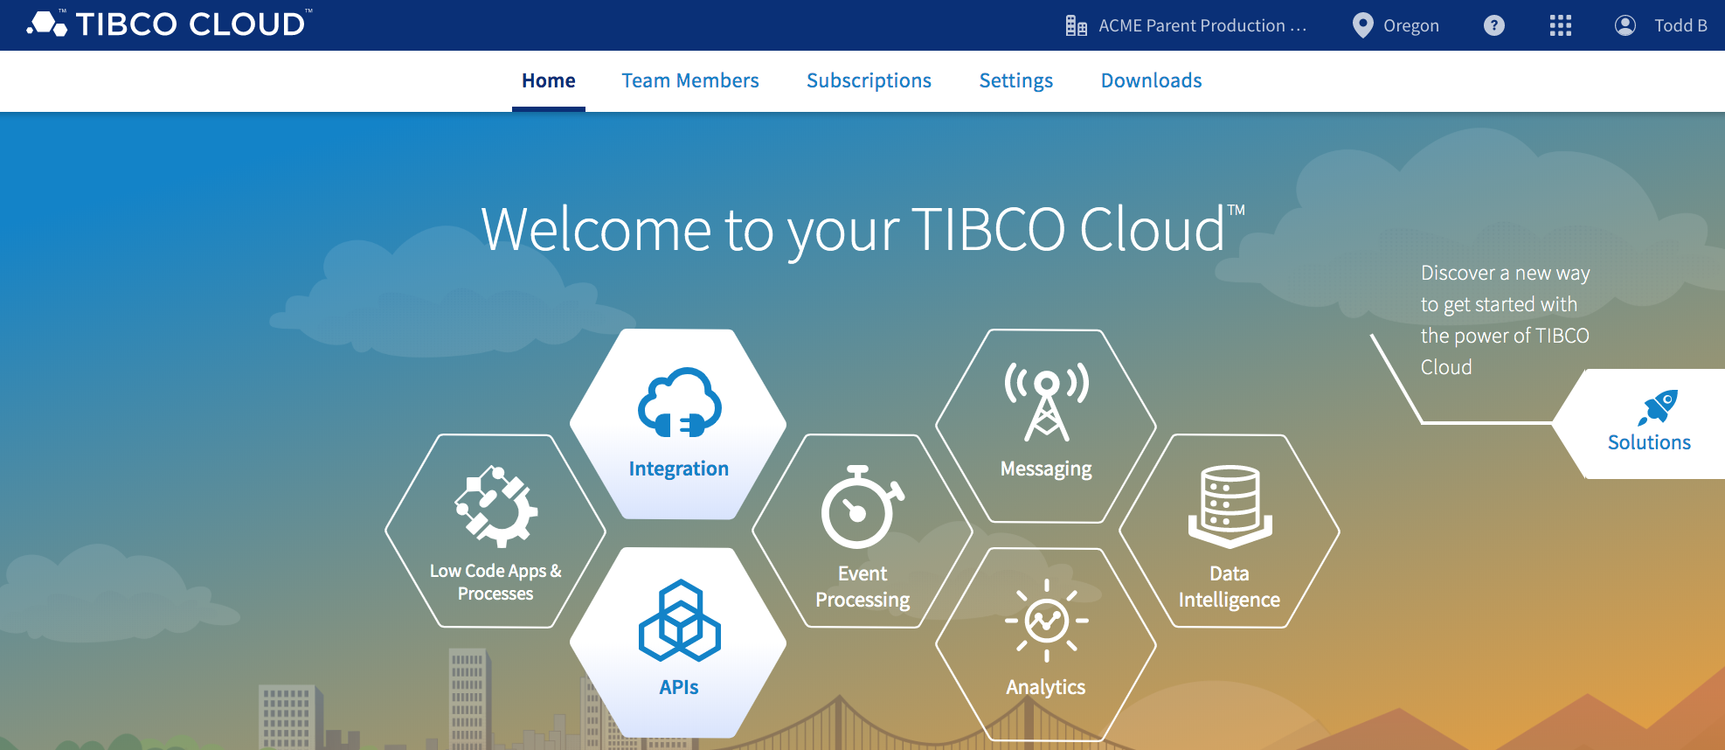
TIBCO Cloud in a Nutshell

Slide 26
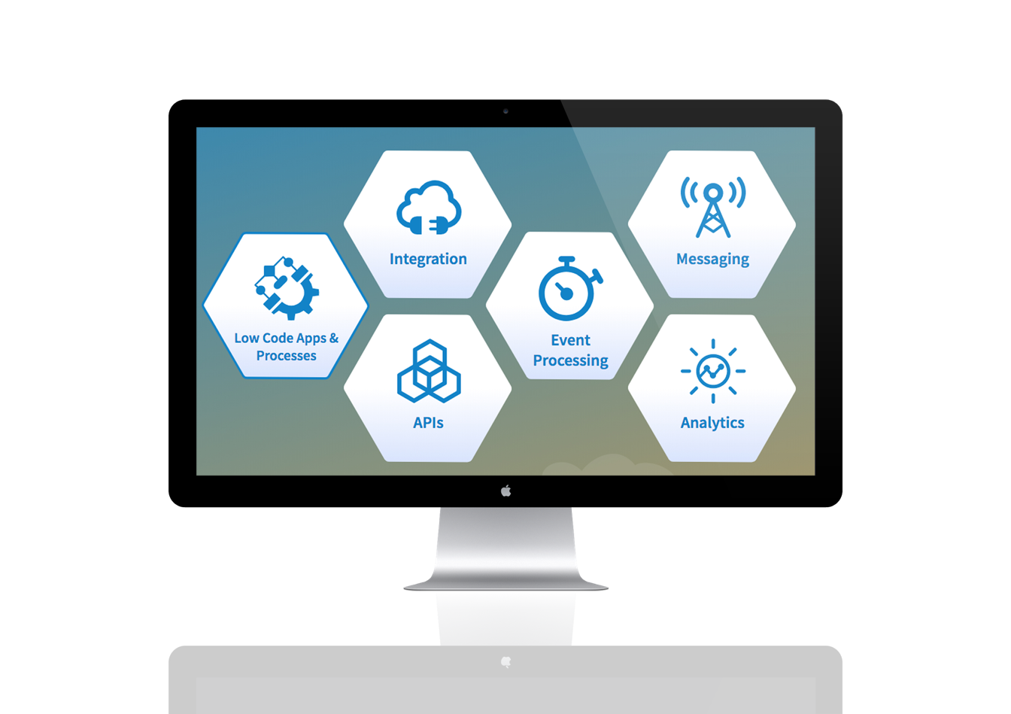
Capabilities available on TIBCO Cloud
TIBCO Cloud Nimbus
TIBCO Cloud Live Apps
TIBCO Cloud Integration
TIBCO Cloud Mashery
TIBCO Cloud AuditSafe
TIBCO Cloud Events
TIBCO Cloud Messaging
TIBCO Cloud Spotfire

Slide 27






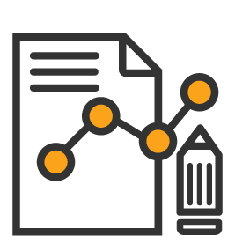



TIBCO Cloud Services
At-a-Glance
High Availability
Disaster Recovery
Security, Privacy, & Compliance
PKI Management
Role-based Access
Auditability
Service Level Agreement
Reporting
Operational Dashboard
Transaction Tracking
Support

Slide 28
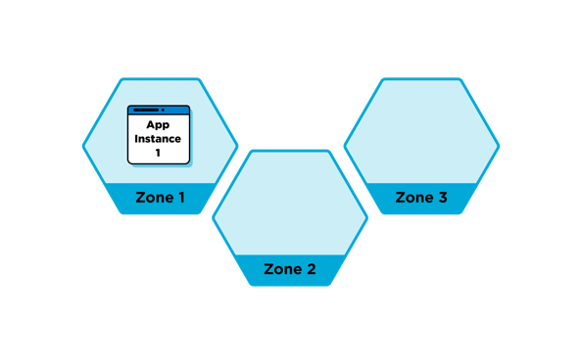
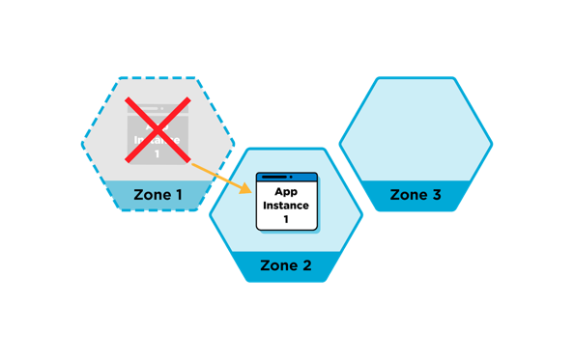
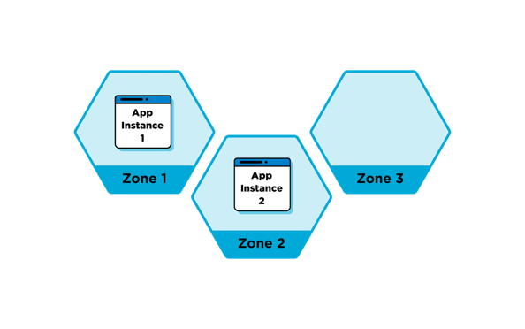
High Availability
Each application is executed in an availability zone automatically selected based on available resources.
Automatic switch-over of apps to new zone if they go down or stop reporting status.
Scale apps across multiple zones for high availability - load is distributed evenly by the system.

Slide 29


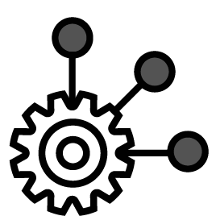
Security, Privacy and Compliance
Multi-tenant platform with logical separation of customers.
Built with privacy and security in mind.
Encrypted network traffic and data storage.
Hybrid Connectivity
Customer traffic, secrets and encryption
Authentication and Authorization
Secure API’s for Mobile and Command line interface

Slide 30









Enable Collaborative Integration for Everyone through Tailored User Experiences
Accelerate API-Led Integrations Across Your Business
CONNECT SaaS business applications
CONNECT
MANAGE APIs for integration
APIs
Citizen Integrator / Business Analyst
API Product Manager
MANAGE
INTEGRATE
INTEGRATE enterprise apps across on-premises and cloud
DEVELOP event-driven microservices and functions
DEVELOP
Integration Specialist
Application Developer

Slide 31

The Labs

Slide 32
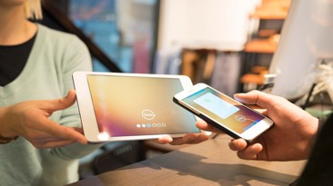











TIBCO Cloud Integration Blueprint
Digital Interface
B2B Interface
Internal API Catalogue
Standard, secure interface for service consumption
TIBCO Mashery
APIs are secured and governed
API Platform
TIBCO Flogo
API
API
API
API
API
API
API
API
API
API
API
API
API
API
API
Interface doesn’t change as services are updated
Shipping Microservices
Customer Microservices
Payment Microservices
Order Microservices
Inventory Microservices
TIBCO BusinessWorks
Complexity of Legacy is abstracted
API
API
API
API
API
API
IoT

Slide 33
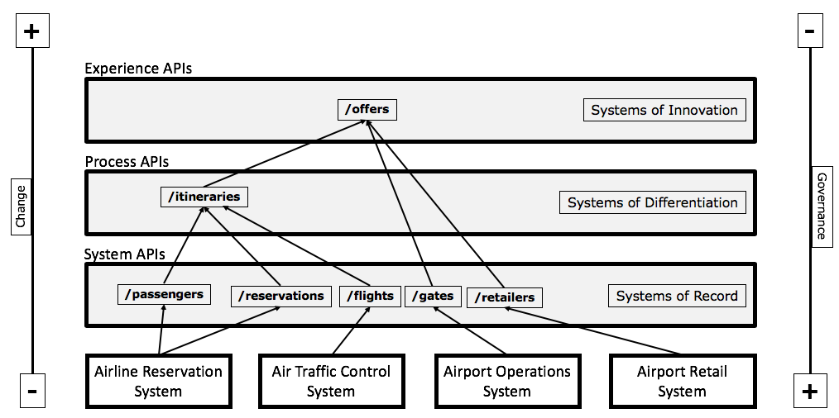
API Network Pattern

Slide 34
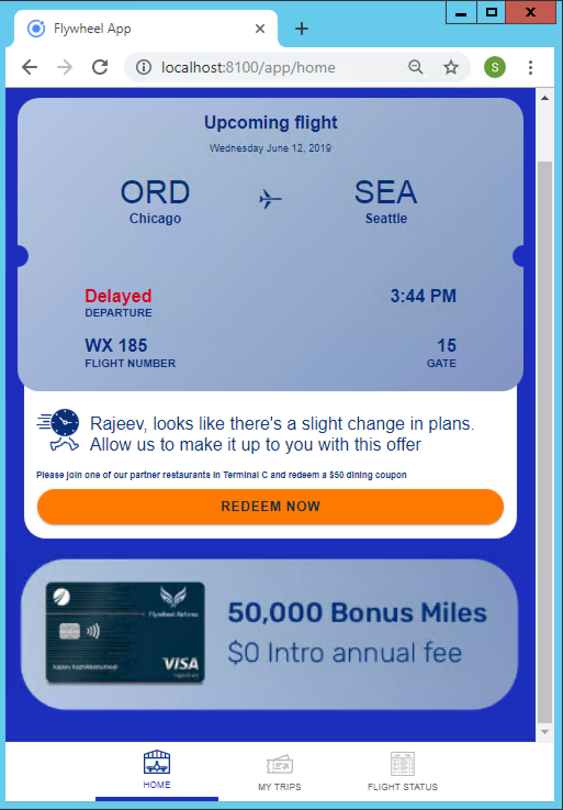
Connected Customer Experience APIs Are Everywhere
Customer iPhone App
Drive additional revenues for Airport by connecting Airport and Retailers with Airlines
Increase Customer Satisfaction by Providing Relevant Real-time information
Real-time Offers and Status to Drive Customers from Gates to Retailers
Seamless experience for your customers
Flight Details
Dynamic Experience
Contextual Offers

Slide 35







Event Driven API-Led Integration Drives Customer Engagement
Flights
Responds with flight status.
Passenger Request Flight Status
Reservations
Responds with reservation details.
Itineraries
Responds with Flight Status, Reservations and Passenger details.
Passengers
Responds with passenger details.
Flight Status
Contextual Offer
Retailers
Responds with average wait time.
Offers
Responds with contextual offer based on flight status, retailers and passenger loyalty.
Decisions
Responds with contextual offer based on loyalty, retailers near gate, wait times.

Slide 36
Use Case: Connected Customer Experience
We will be exploring and building the APIs for Connected Customer Experience Airport iPhone App
We will concentrate on speed and agility
We will focus on Process and Event APIs
The persona will be an IT savvy business analyst
We will construct new process and experience APIs with readily available APIs
Notes:
How are mobile apps created?
Mobile app developers require APIs; Mobile App developer needs access to your API Network; this starts with the experience APIs.
APIs start their life with a API-Spec - This is the blueprint that everyone agrees to
The Expectation on how the API will work
Input, Outputs
APIs are then implemented, reviewed, tested, deployed
This APIs are delivered and reused by your business to create mobile, chatbot, and more…
APIs are managed and discovered via app stores
APIs allow more expensive resources, such as data scientist and IT specialist to create useable API that can be used throughout an enterprise to build Web Sites, ChatBot, Conversations (Alexa).
APIs enable your business to scale. Enable more people to do more…

Slide 37
Empowering an agile, productive API lifecycle
CONSUME
MANAGE
DESIGN
BUILD
Verify Spec with Partners
On-board Early Adopters
Collect Feedback
Production Launch
Partner Manager
Publish Mock API
Monitor Usage Trends
Refine Policies
Publish Production API
Digital Product Manager
Model API
Share API
Create Mock App & Export API
Additional config
Publish App Endpoint
API Designer
Generate Application
Stub
Design & Build Application
Test locally
Deploy to Cloud
API Developer

Slide 38
Connected Customer Experience App
1
2
3
4
5
6
The TIBCO Cloud
Import and Explore APIs
Implement & Test APIs
Contextual Offers
Cloud Analytics
Mock APIs
Sign in and get familiar with the TIBCO Cloud Platform
Import existing Spec. Explore API and Extend for our App.
Fake it before you make it! Get Digital Teams working against your Mock APIs whilst you do the real work.
Build out your API by implementing a Flo(go) application that orchestrates and re-uses existing APIs
Use Cloud Events to create Contextual Customer Offers in your Event Driven Cloud Architecture
Explore Analytics in the Cloud

Slide 39
Connected Customer Experience App
1
2
3
4
5
6
The TIBCO Cloud
Import and Explore APIs
Implement & Test APIs
Contextual Offers
Cloud Analytics
Mock APIs
Sign in and get familiar with the TIBCO Cloud Platform
Import existing Spec. Explore API and Extend for our App.
Fake it before you make it! Get Digital Teams working against your Mock APIs whilst you do the real work.
Build out your API by implementing a Flo(go) application that orchestrates and re-uses existing APIs
Use Cloud Events to create Contextual Customer Offers in your Event Driven Cloud Architecture
Explore Analytics in the Cloud

Slide 40



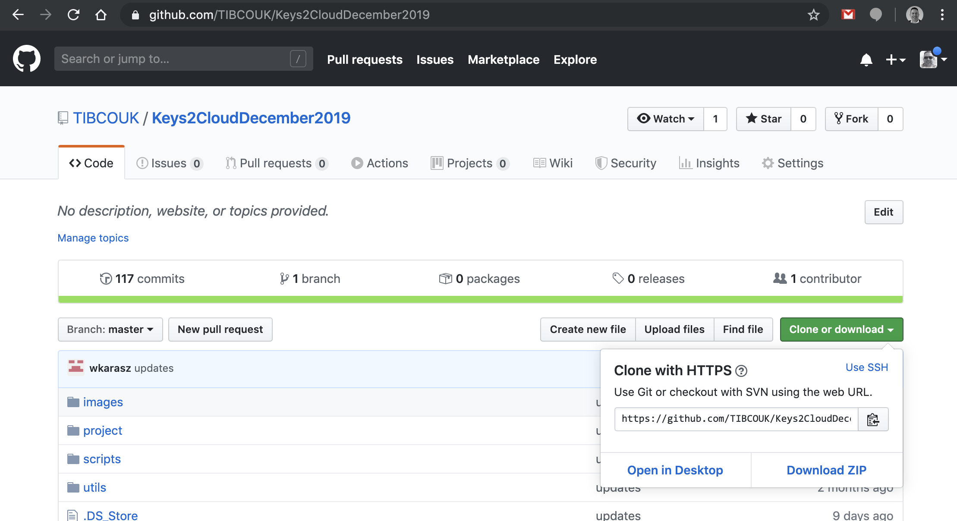


Key Resources
1
http://cloud.tibco.com
Download and extract the Hands On Lab : https://github.com/TIBCOUK/Keys2CloudDecember2019
TIBCO Community :
https://community.tibco.com/products/tibco-cloud-integration
https://community.tibco.com/products/tibco-activematrix-businessworks
Docs TIBCO : https://docs.tibco.com/
TIBCO Flogo : http://www.flogo.io/
The TIBCO Cloud

Slide 41
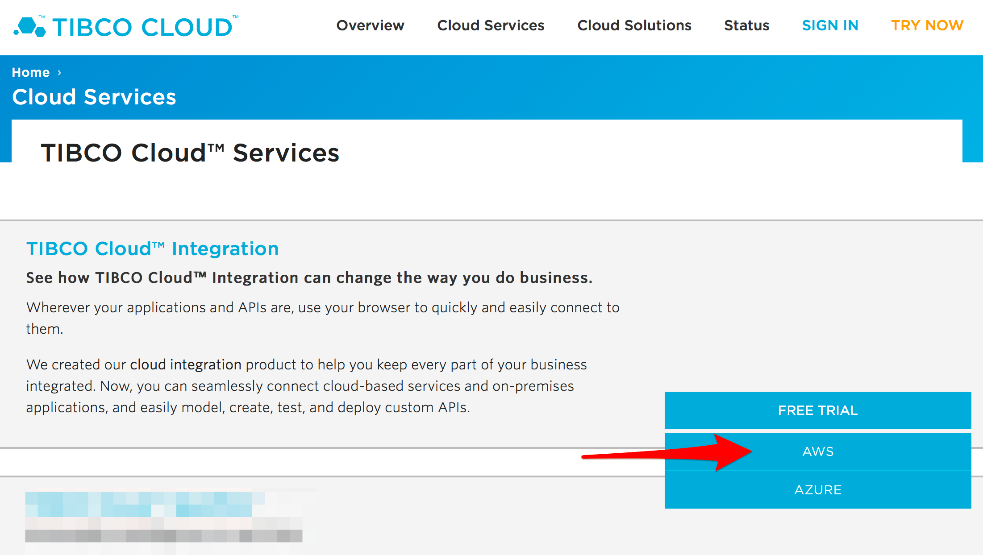
Sign-up
1
Go to cloud.tibco.com
https://cloud.tibco.com
Register
Login: your email address
Password: your password
Region: EU (Ireland)
Check your email for activation email
And Junk folder!
The TIBCO Cloud

Slide 42
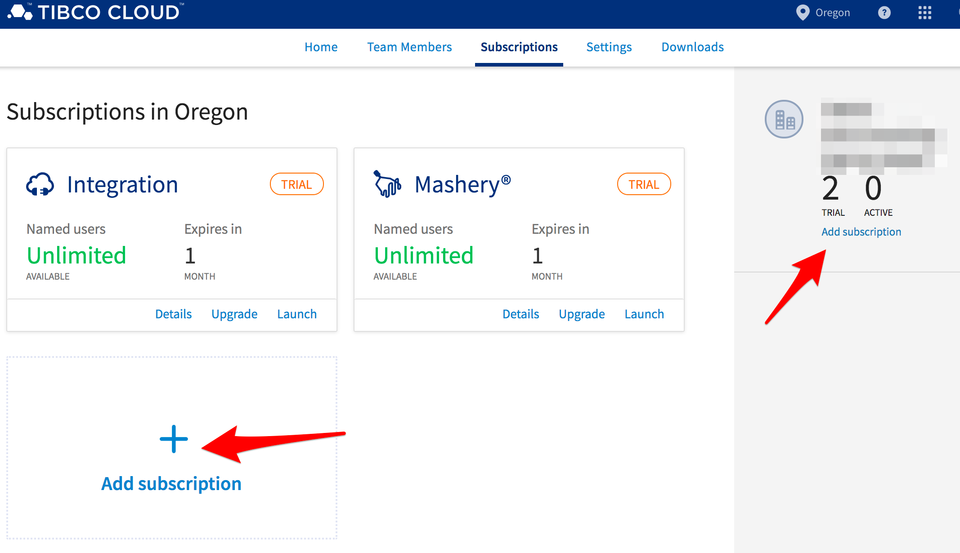
Add Subscriptions to the Trial
1
The TIBCO Cloud

Slide 43
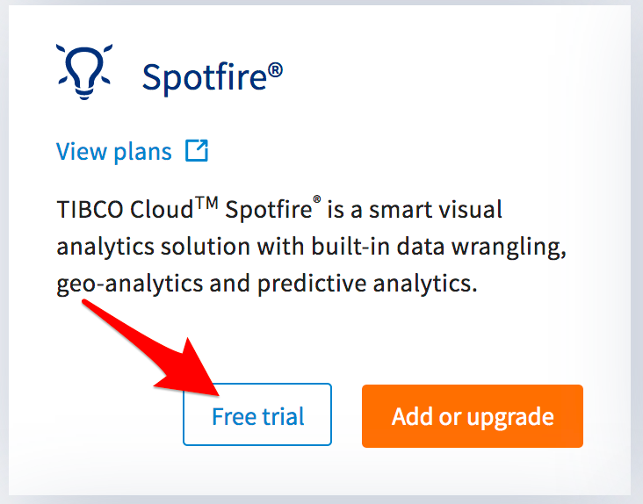
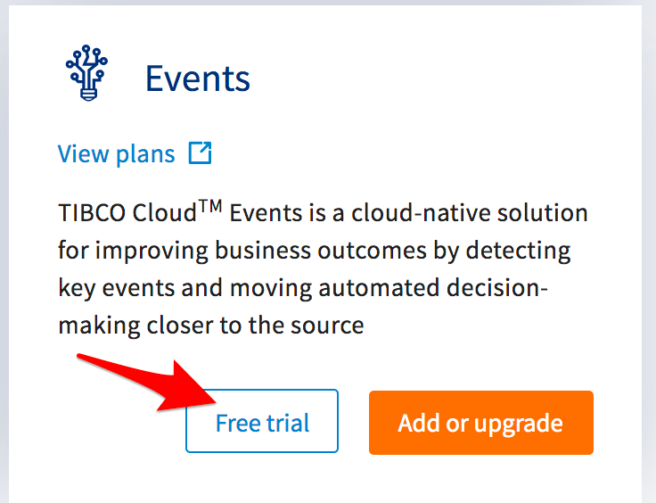
Add Spotfire and Events
1
The TIBCO Cloud

Slide 44
Connected Customer Experience App
1
2
3
4
5
6
The TIBCO Cloud
Import and Explore APIs
Implement & Test APIs
Contextual Offers
Cloud Analytics
Mock APIs
Sign in and get familiar with the TIBCO Cloud Platform
Import existing Spec. Explore API and Extend for our App.
Fake it before you make it! Get Digital Teams working against your Mock APIs whilst you do the real work.
Build out your API by implementing a Flo(go) application that orchestrates and re-uses existing APIs
Use Cloud Events to create Contextual Customer Offers in your Event Driven Cloud Architecture
Explore Analytics in the Cloud

Slide 45
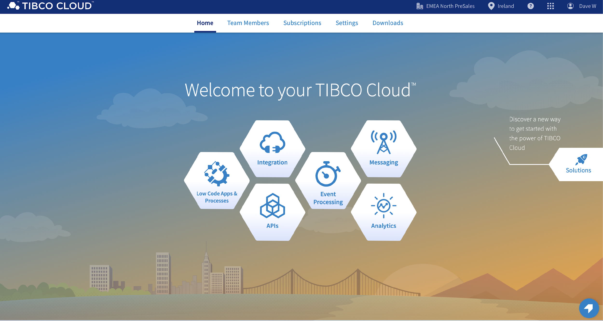
Log into TIBCO Cloud
2
Import and Explore APIs
Main Home Page
Shows which Capabilities are available to your subscription
Can change Regions
See and Manage Team Members
Subscribe to new Capabilities
Access Help

Slide 46
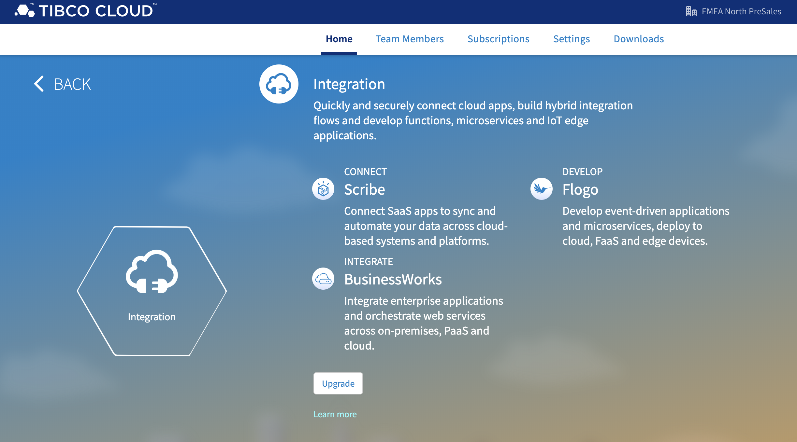
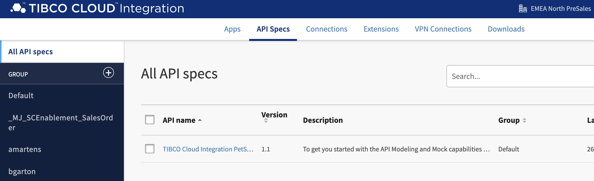
Importing API Specs.
2
Import and Explore APIs
Navigate to API Spec
Click on “Integration”
Click on “Flogo” or “BusinessWorks”
Click on “API Specs”
API Specs allows us to
Create new APIs
Import existing APIs
Create Mock Applications
Generate Application Skeletons (NodeJS and Flogo)

Slide 47
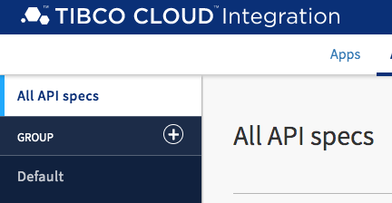
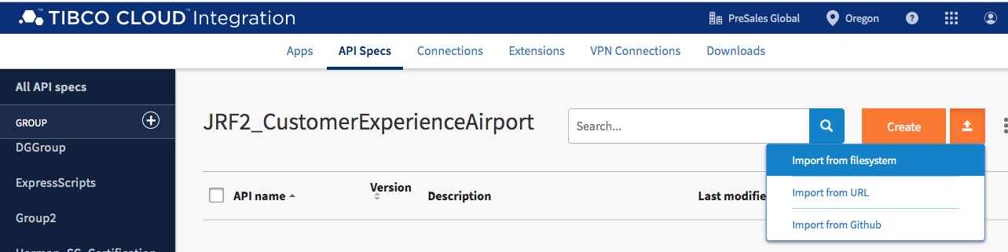
Importing API Specs.
2
Create a new Group (Click the + sign)
Call it CustomerExperienceAirport
Select the new Group
You’ll see an empty list
Import and Explore APIs
Import API Spec
Import from Filesystem and navigate to where you extracted the connected customer experience artifacts
Choose project/apispecs/APISpecs/v2/passengers.json

Slide 48
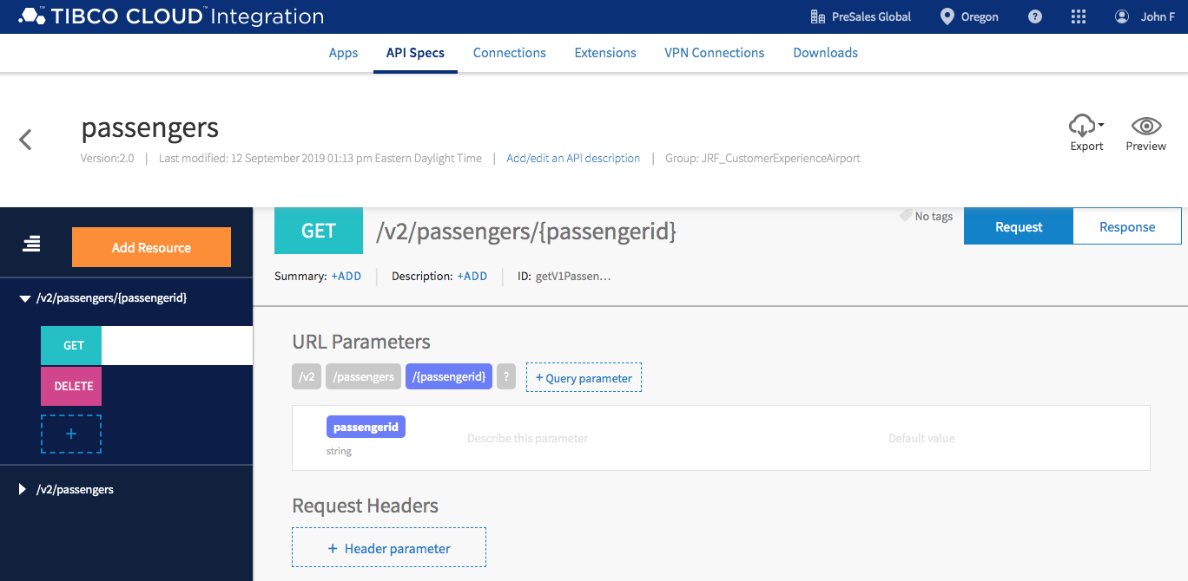
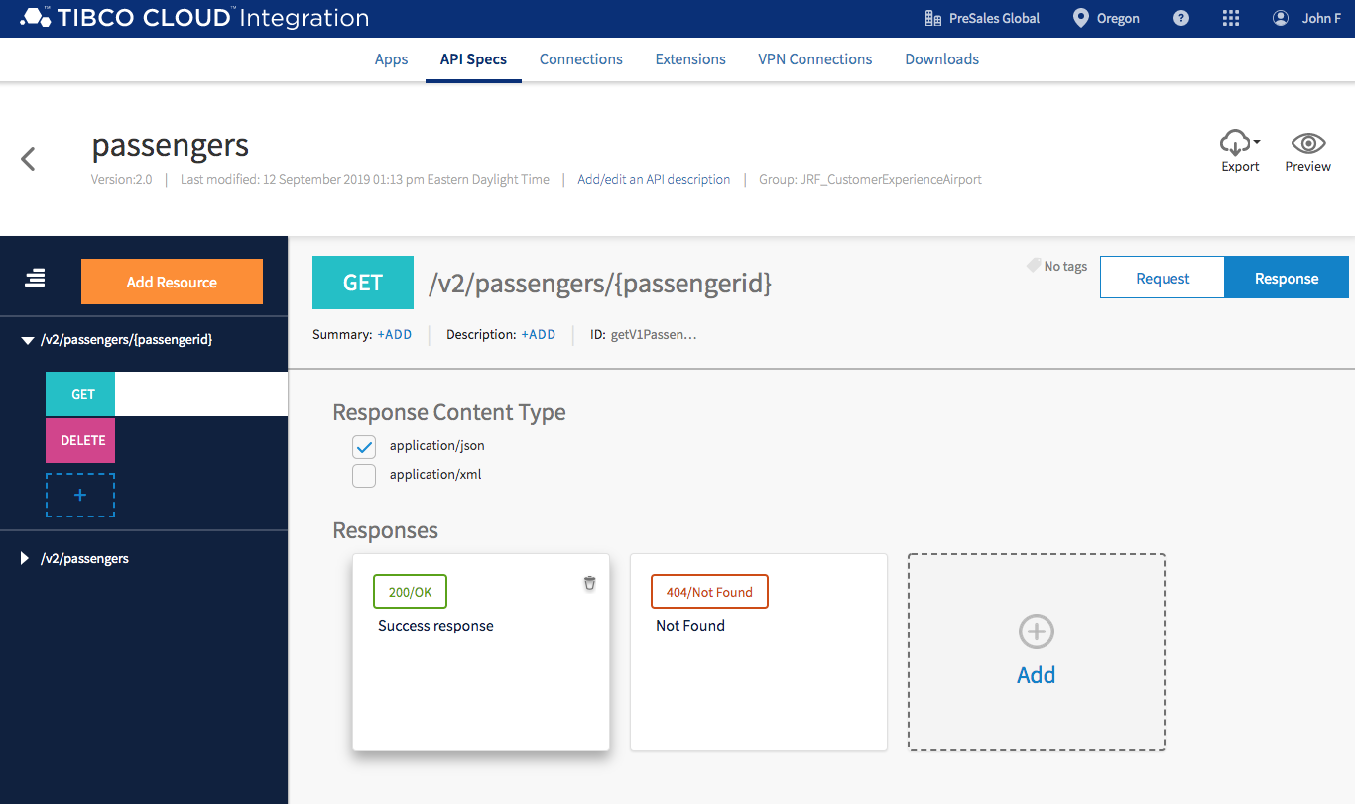
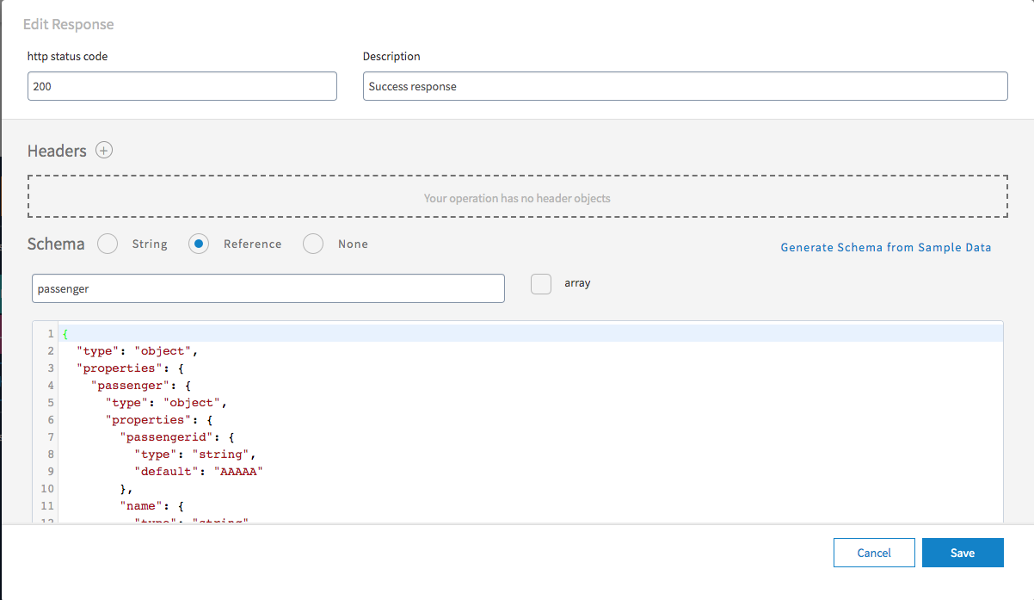
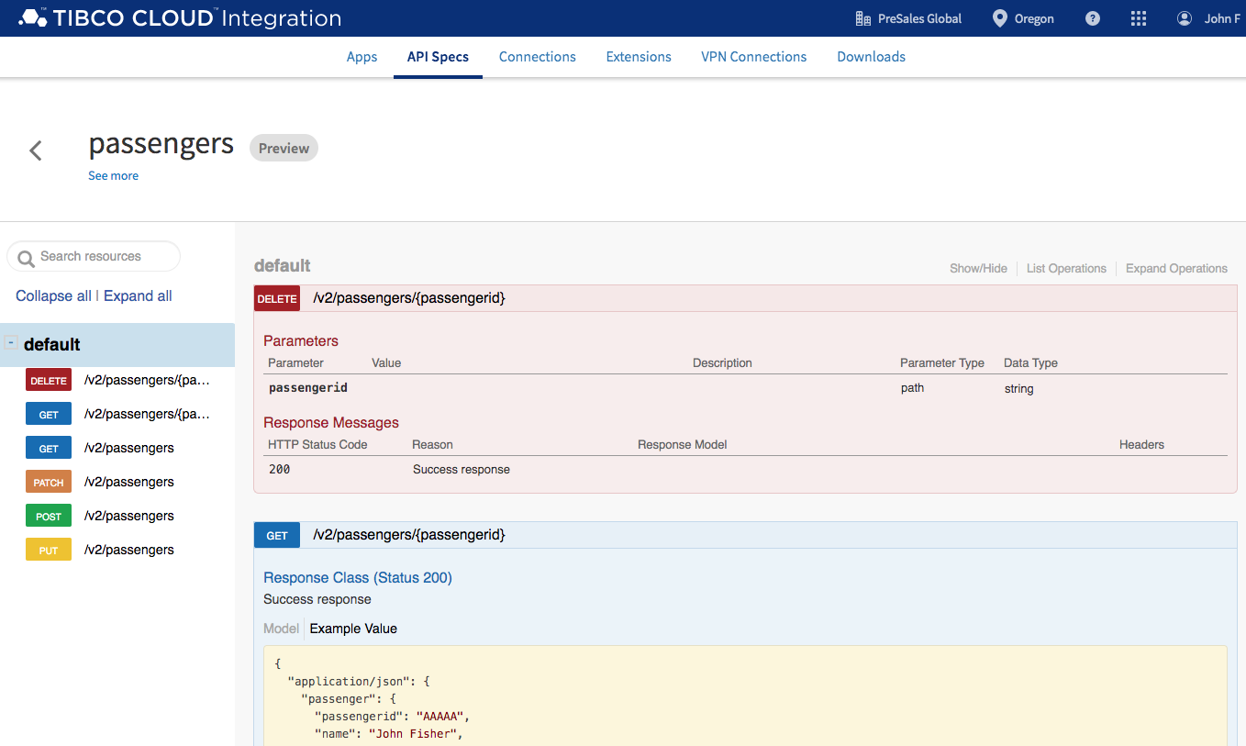
Exploring the API.
2
Explore the new API
Responses
Import and Explore APIs
Example Success Response
Preview API

Slide 49
Connected Customer Experience App
1
2
3
4
5
6
The TIBCO Cloud
Import and Explore APIs
Implement & Test APIs
Contextual Offers
Cloud Analytics
Mock APIs
Sign in and get familiar with the TIBCO Cloud Platform
Import existing Spec. Explore API and Extend for our App.
Fake it before you make it! Get Digital Teams working against your Mock APIs whilst you do the real work.
Build out your API by implementing a Flo(go) application that orchestrates and re-uses existing APIs
Use Cloud Events to create Contextual Customer Offers in your Event Driven Cloud Architecture
Explore Analytics in the Cloud

Slide 50
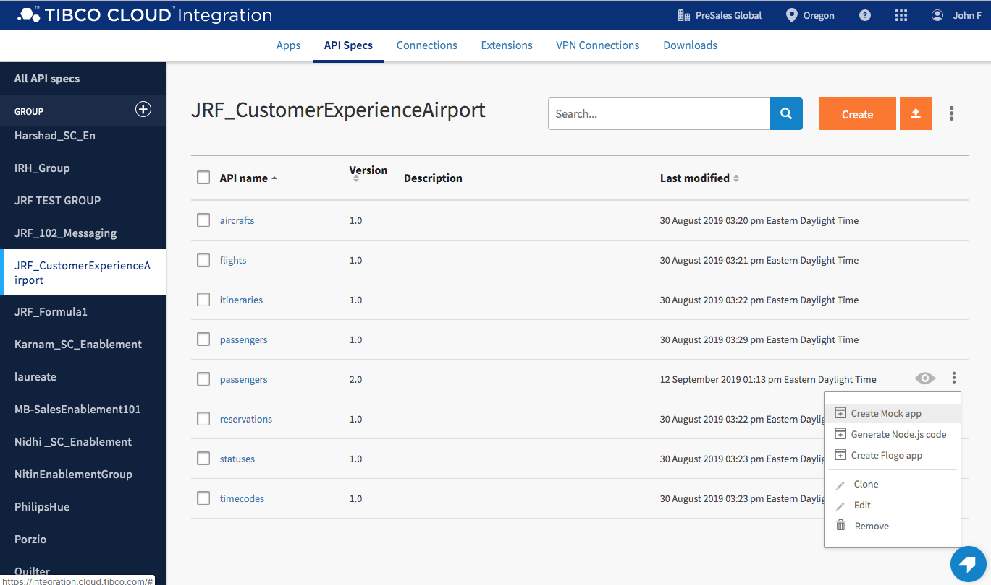
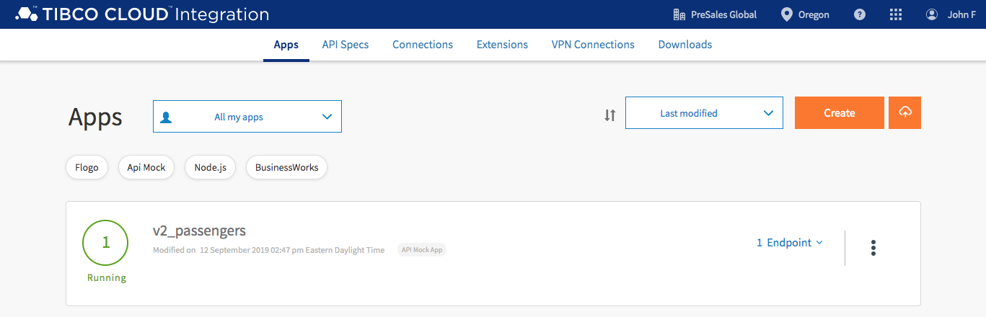
Mock APIs
3
Create a Mock API
Allows you to test quickly
Provide Developers with an Endpoint
They can start developing their application straight away
Click on the 3 dots next to the API and click ”Create Mock App”
Give your app a Name
Wait until the App shows “Running”
Mock APIs

Slide 51
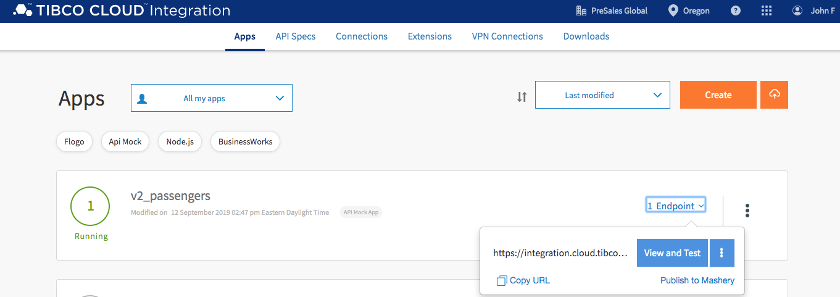
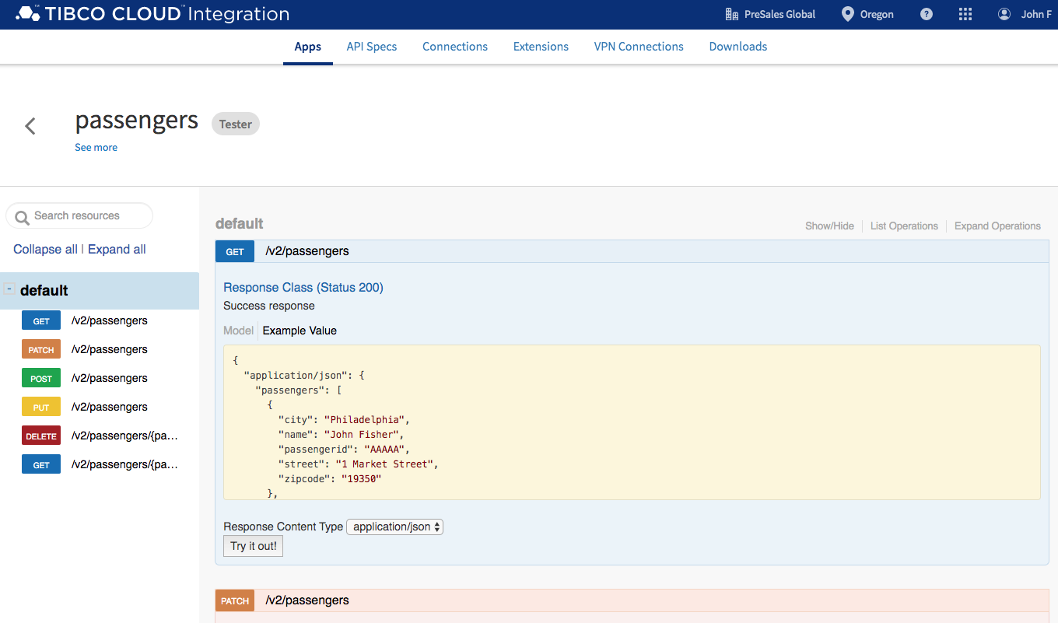
Mock APIs
3
Test your Mock API
Click on the Endpoint
Click on View and Test
Select Try it out!
Under GET /v2/passengers.
Mock APIs
Result returned (from Success response)

Slide 52
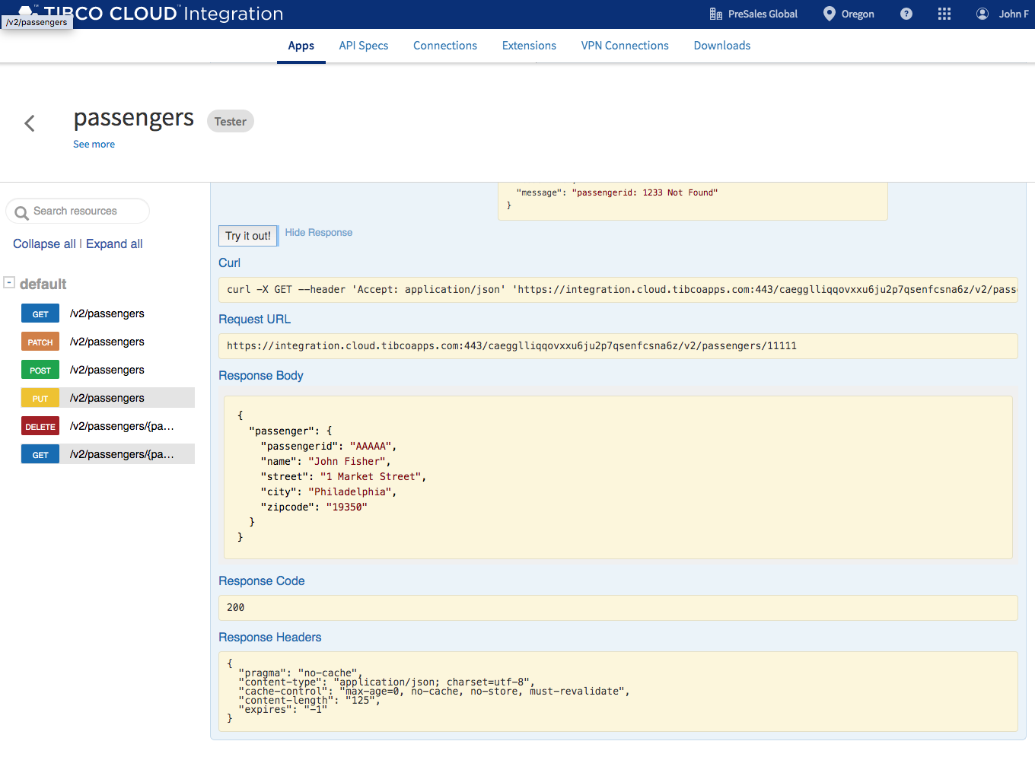
Mock APIs
3
More Testing
Try testing /v2/passengers/{passengerid}.
Select or scroll down to /v2/passengers/{passengerid}. Enter 11111 in passengerid parameter and select Try it out!
Mock APIs

Slide 53
Connected Customer Experience App
1
2
3
4
5
6
The TIBCO Cloud
Import and Explore APIs
Implement & Test APIs
Contextual Offers
Cloud Analytics
Mock APIs
Sign in and get familiar with the TIBCO Cloud Platform
Import existing Spec. Explore API and Extend for our App.
Fake it before you make it! Get Digital Teams working against your Mock APIs whilst you do the real work.
Build out your API by implementing a Flo(go) application that orchestrates and re-uses existing APIs
Use Cloud Events to create Contextual Customer Offers in your Event Driven Cloud Architecture
Explore Analytics in the Cloud

Slide 54
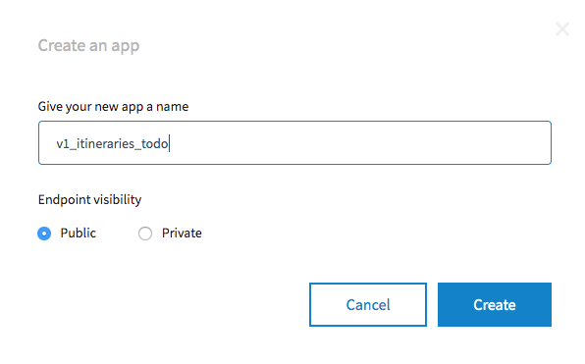
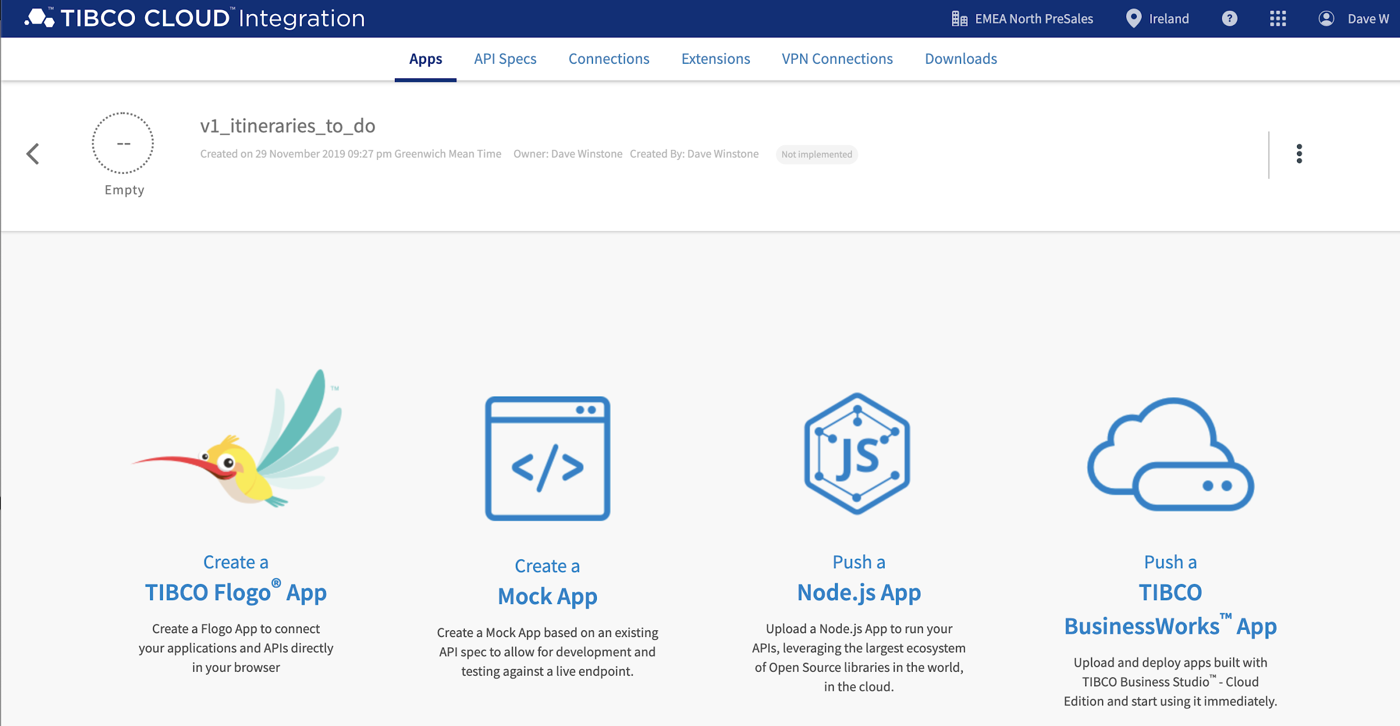
Implement API
4
Extend API implementation by re-using existing API to include Aircraft Details
We’ll use an existing Flogo Application
Add new steps to call Flights API
Click on Apps
Click Create
Give it a Name + Click Create
Click on “Flynn” to create a TIBCO Flogo App
Implement & Test APIs

Slide 55
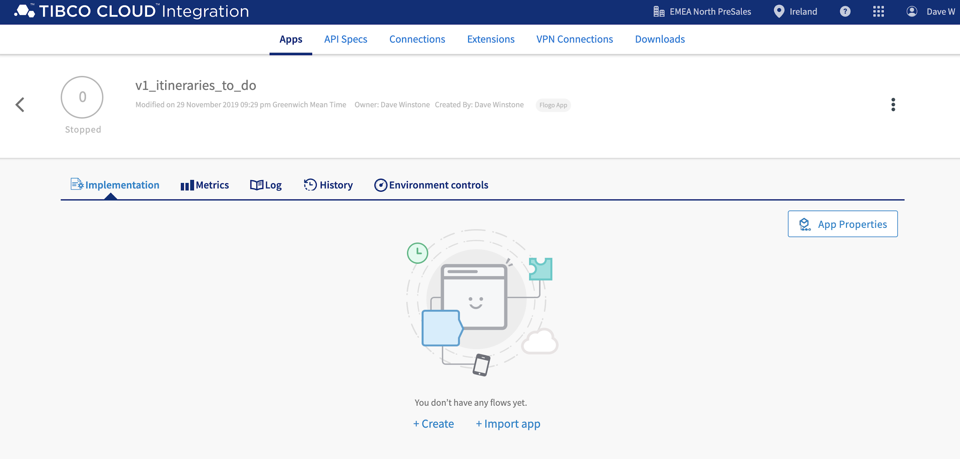
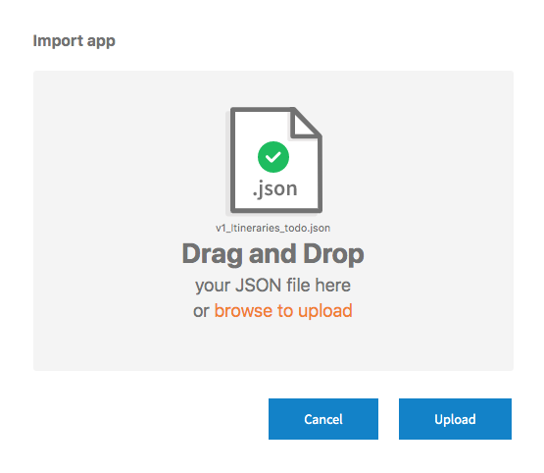
Implement API
4
Import pre-built Application…
Click on Import App
Navigate to where you extracted the connected customer experience artifacts and drag project/apispecis/TCI/itineraries_lab/v1_itineraries_todo.json into upload files and select Upload.
Implement & Test APIs

Slide 56
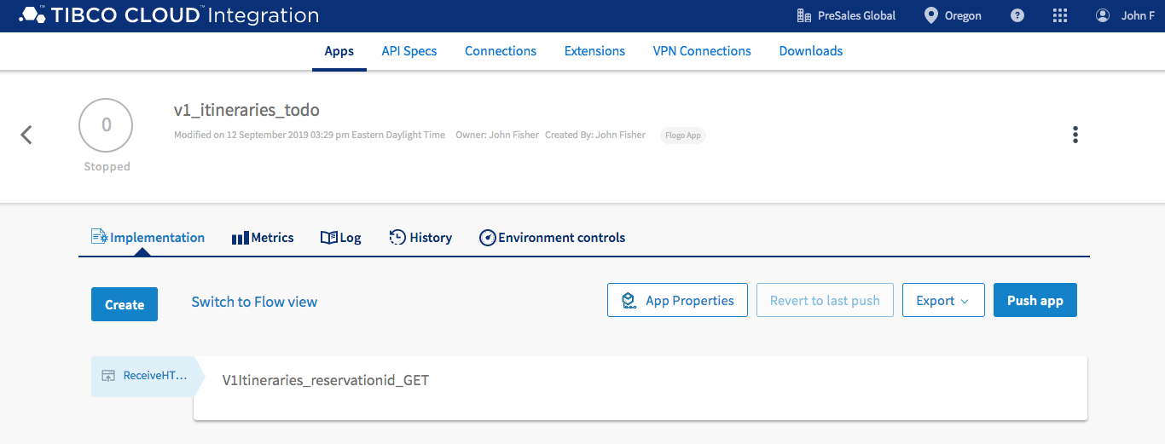
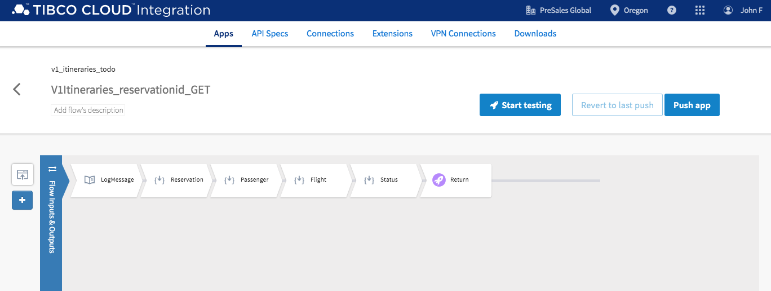
Implement API
4
Flogo Application implements the API we used earlier
Click on V1Itineraries_reservationid_GET to view the implementation
Implement & Test APIs
Flogo Implementation

Slide 57
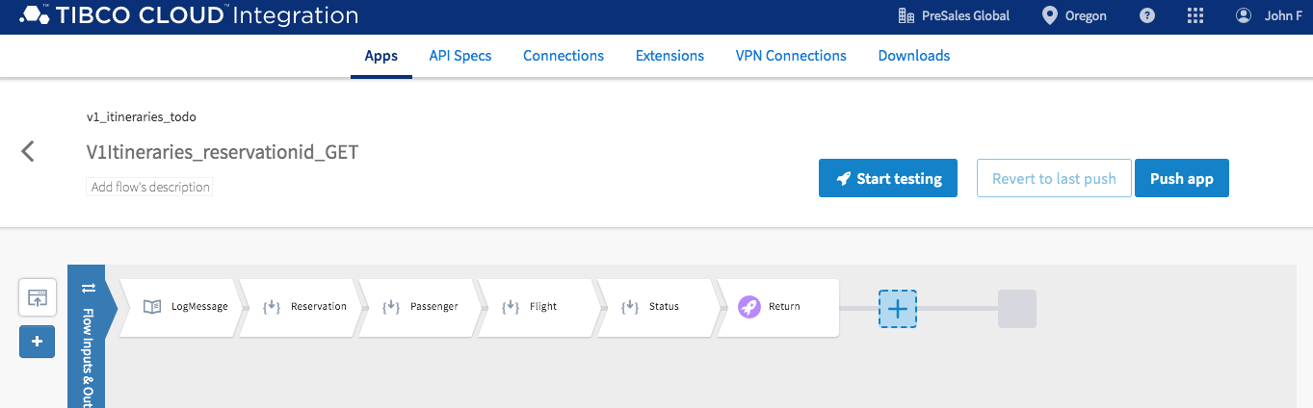
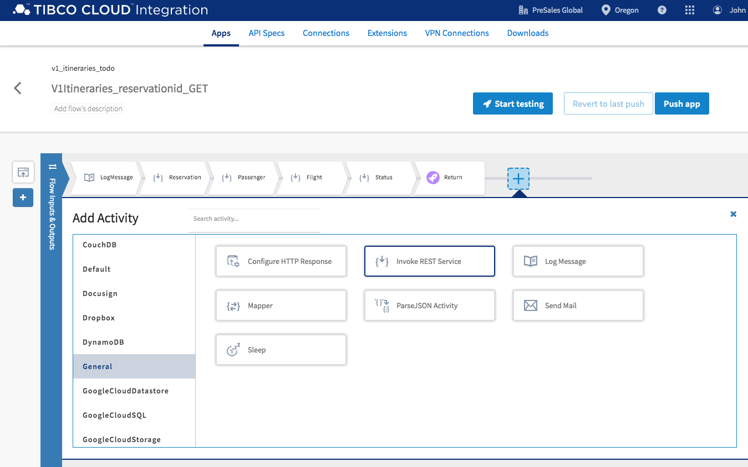
Implement API
4
Hover over the box to the right of “Return” to reveal a + sign and click on it to add a new Activity
From Add Activity, scroll down, select General, select Invoke REST Service.
Implement & Test APIs

Slide 58
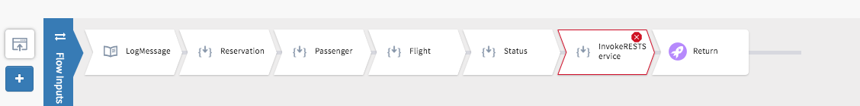
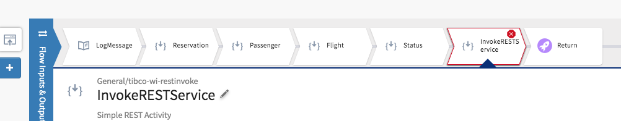
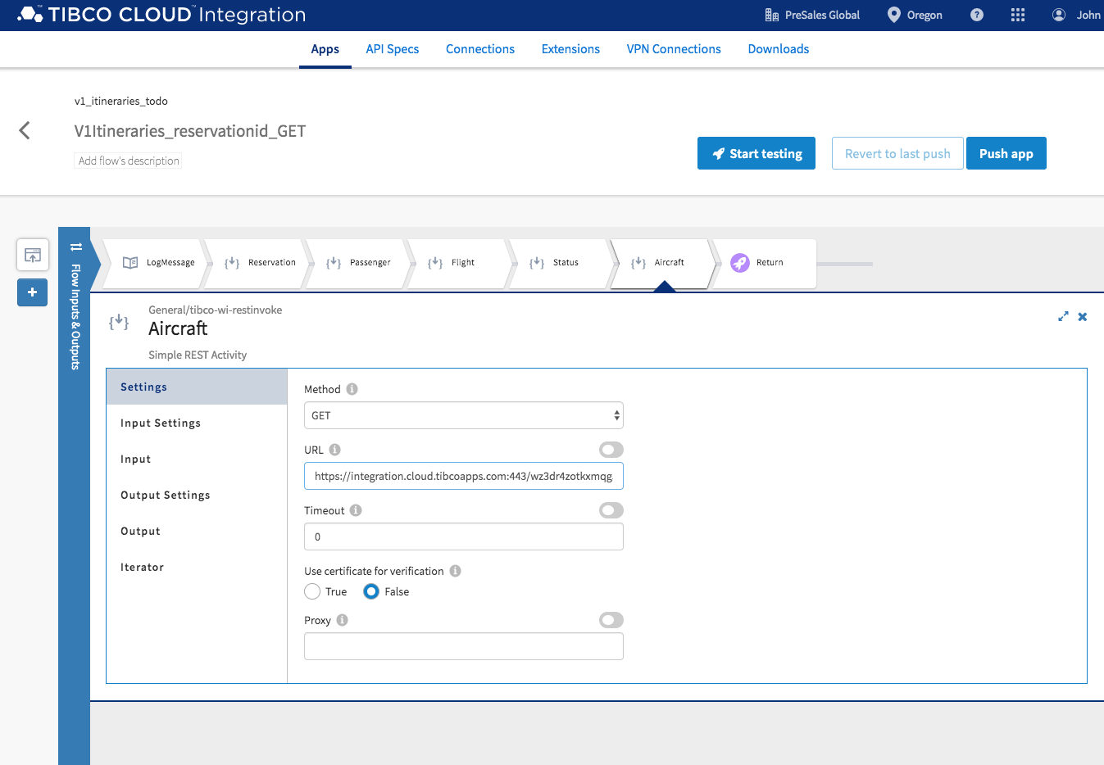
Implement API
4
Drag the InvokeRESTService to the right of Status.
Implement & Test APIs
Rename the activity. Select InvokeRESTService, hover your mouse over the name InvokeRESTService and select the edit icon.
Add REST URL - Select “Settings” and past the following URL in the URL field.
https://integration.cloud.tibcoapps.com:443/wz3dr4zotkxmqg5au6yhc526iw2otlc2/v1/aircrafts/{aircraftid}

Slide 59
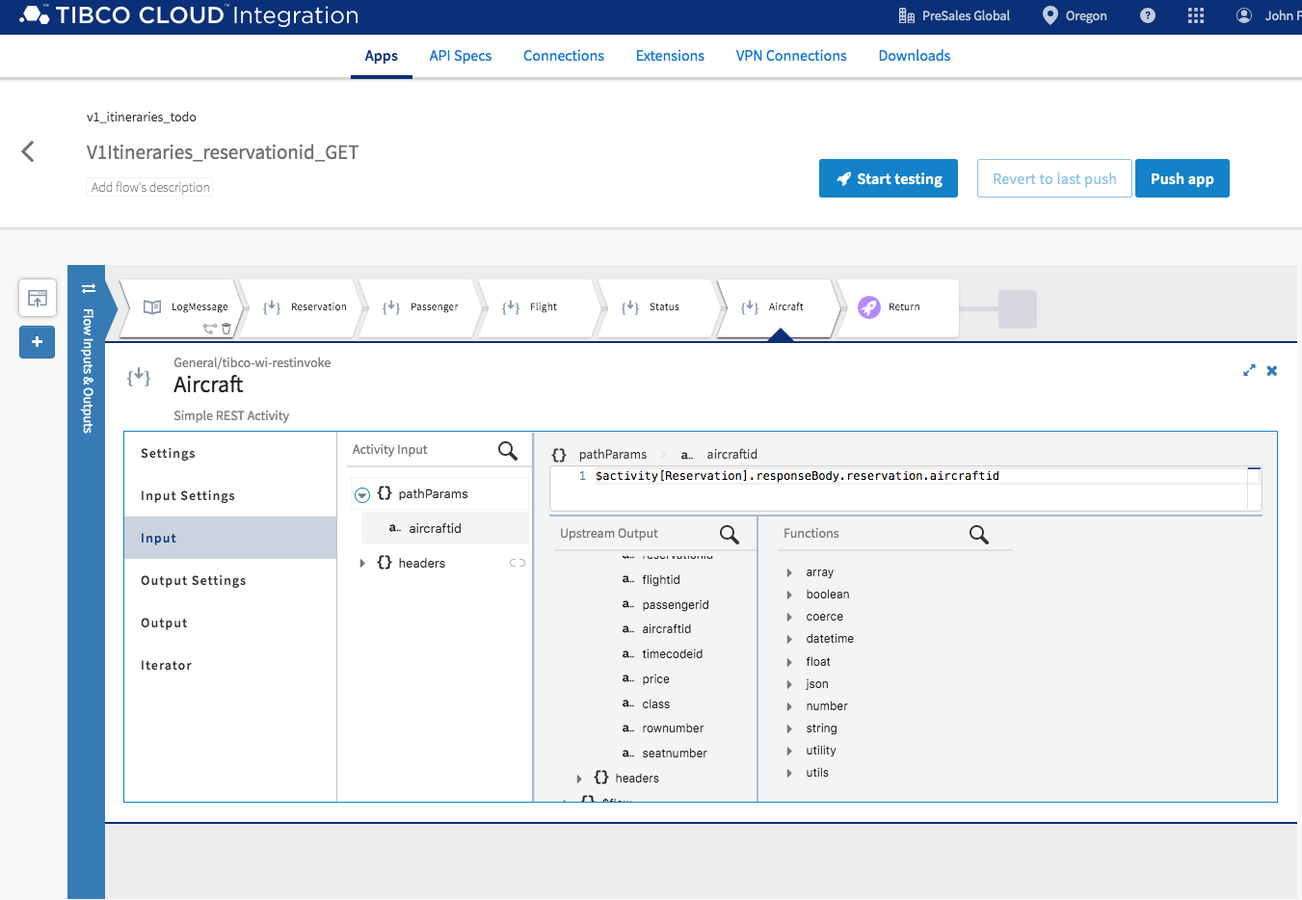
Implement API
4
Now let’s map activity input. Select “Input”, expand pathParams and select aircraftid.
Expand Upstream Output->Reservation->responseBody->reservation and select aircraftid.
This maps the output of previous steps in the Flogo application
Functions etc. can be used to manipulate the data
Implement & Test APIs

Slide 60
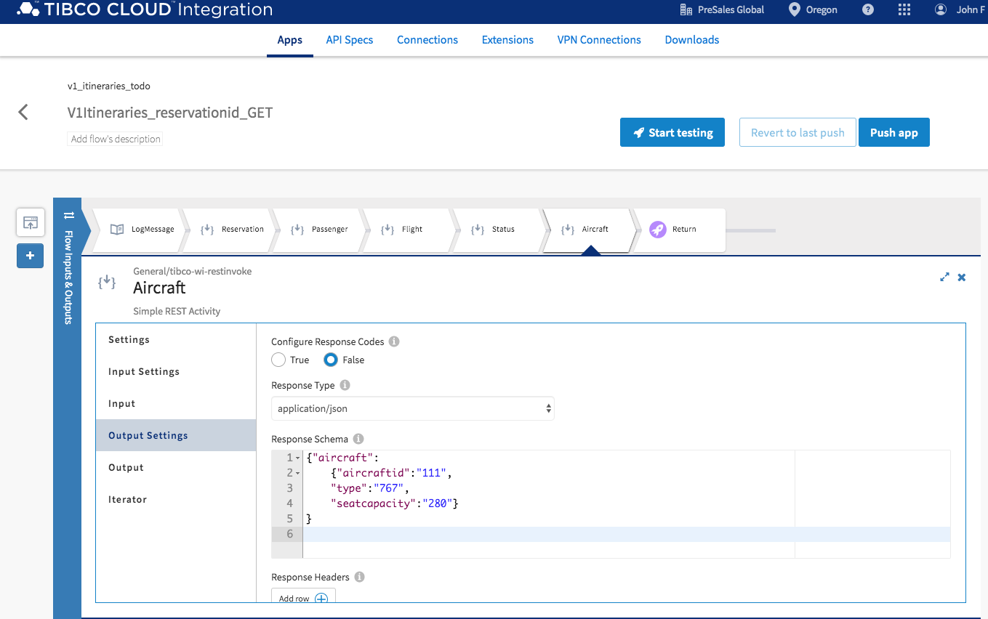
Implement API
4
We now need to configure the Output Schema of the API Call
Configure the Output settings. Select Output Settings and past the following schema into Response Schema.
{"aircraft":
{"aircraftid":"111",
"type":"767",
"seatcapacity":"280"}
}
Implement & Test APIs

Slide 61

Implement API
4
Next – we need to map the response of the Aircraft API to the final return value of the Itinerary API
Select Return activity, expand Flow Outputs itinerary and select aircraft. In upstream Output Aircraft, expand Aircraft->responseBody, select aircraft.
Implement & Test APIs

Slide 62


Test API
4
Click on Start Testing
Implement & Test APIs
Create a “Launch Configuration” to set up some test input data

Slide 63


Test API
4
Expand Activity Input flowInputs->pathParams->reservationid. And enter ‘AAAAA11111’ into flowInputs. Use quotes. Select Next. Select Run.
Implement & Test APIs
Detailed Logging shows testing results

Slide 64


Deploy API
4
Select “Push App”
Implement & Test APIs
Wait until Deployment completed
Scale button can be used to scale applications up/down

Slide 65


Test Deployed API
4
Test your live endpoint by selecting Endpoint, select View and Test.
Implement & Test APIs
Enter AAAAA11111 for reservationid input parameter and select Try it out!

Slide 66
Connected Customer Experience App
1
2
3
4
5
6
The TIBCO Cloud
Import and Explore APIs
Implement & Test APIs
Contextual Offers
Cloud Analytics
Mock APIs
Sign in and get familiar with the TIBCO Cloud Platform
Import existing Spec. Explore API and Extend for our App.
Fake it before you make it! Get Digital Teams working against your Mock APIs whilst you do the real work.
Build out your API by implementing a Flo(go) application that orchestrates and re-uses existing APIs
Use Cloud Events to create Contextual Customer Offers in your Event Driven Cloud Architecture
Explore Analytics in the Cloud

Slide 67

Event Driven APIs to provide Contextual Offers
5
Contextual Offers
We’ll start with a prebuilt solution. This solution will create an API that makes an offer decision based on passenger loyalty and flight status.
From the TIBCO Cloud Home Screen – select Event Processing, followed by “Events”

Slide 68


Event Driven APIs to provide Contextual Offers
5
Contextual Offers
The “You don’t have any apps yet” page should be opened.
Select Upload, cloud with up-arrow.
Navigate to where you extracted the connected customer experience artifacts and drag project/CloudEvents/PassengerOffer.ear into Drag and Drop and select Push.
The PassengerOffer project files will be pushed to the cloud and started.

Slide 69



Event Driven APIs to provide Contextual Offers
5
Contextual Offers
Wait until the application is running
Select 2 Endpoints and choose PassengerOffer Swagger link.
Expand the GET Method and select “Try it out”
Enter the values as shown and press “Execute”

Slide 70

Event Driven APIs to provide Contextual Offers
5
Contextual Offers
The offer, shown below, is Dinner At Chilis.
Try different input options
passengerid | loyaltystatus | flightstatus
11111 | BRONZE | DELAY1
11111 | SILVER | DELAY1
11111 | GOLD | DELAY1
11111 | BRONZE | DELAY2
11111 | SILVER | DELAY2
11111 | GOLD | DELAY2
11111 | BRONZE | DELAY3
11111 | SILVER | DELAY3
11111 | GOLD | DELAY3

Slide 71

Updating Real time Decisions
5
Contextual Offers
We are going to use WebStudio to make changes to the Cloud Events decision table.
To do this, we need to provision the PassengerOffer App to WebStudio.
Click Back on your Web Browser to return to the home screen of TIBCO Cloud Events
Select Provision App to WebStudio from the dropdown and wait for dialog indicating the provisioning was successful.

Slide 72


Updating Real time Decisions
5
Contextual Offers
Select WebStudio. Navigate to Dashboard.
The dashboard shows all recent activities.
Navigate to Workspace.
We are going to check out project artifacts and make changes. Select +

Slide 73

Updating Real time Decisions
5
Contextual Offers
Select PassengerOffer and select Confirm.
This will check out all PassengerOffer artifacts.

Slide 74


Updating Real time Decisions
5
Contextual Offers
We are going to make changes to the PassengerOffer decision table.
Select offerDecision from ARTIFACTS list.
In the offerDecision table scroll down to row 6 where SILVER, DELAY2 and “Happy Meal” is displayed.
Change “Happy Meal” to “Philly Cheesesteak and Coke”.
Select Save.

Slide 75


Updating Real time Decisions
5
Contextual Offers
Commit your changes. Select Commit, add a message and select Confirm.
Select show resources as tree.

Slide 76


Deploying Real time Decisions
5
Contextual Offers
Right-click on PassengerOffer and select Generate Deployable.
Select PassengerOffer and select Confirm.
Select Dashboard, select >PassengerOffer from recent activity and select Deploy.

Slide 77



Testing Changes to Real time Decisions
5
Contextual Offers
Navigate to Cloud Events Apps Home Page and select 2 Endpoints PassengerOffer - /swagger.
Expand GET Method and select Try it out.
Fill in the values as shown
New offer should be shown

Slide 78
Connected Customer Experience App
1
2
3
4
5
6
The TIBCO Cloud
Import and Explore APIs
Implement & Test APIs
Contextual Offers
Cloud Analytics
Mock APIs
Sign in and get familiar with the TIBCO Cloud Platform
Import existing Spec. Explore API and Extend for our App.
Fake it before you make it! Get Digital Teams working against your Mock APIs whilst you do the real work.
Build out your API by implementing a Flo(go) application that orchestrates and re-uses existing APIs
Use Cloud Events to create Contextual Customer Offers in your Event Driven Cloud Architecture
Explore Analytics in the Cloud

Slide 79
Cloud Analytics
6
Cloud Analytics
We’ll start with a prebuilt Dashboard with embedded Data.
From the TIBCO Cloud Home Screen – select Analytics Processing, followed by “Spotfire”

Slide 80

Cloud Analytics
6
Cloud Analytics
Select “Browse Local File”
Navigate to where you extracted the connected customer experience artifacts and select project\Analytics\SFO GIS Analysis.dxp
Select open.

Slide 81

Cloud Analytics
6
Dashboard shows the results of a customer satisfaction survey.
Select a category such as Restaurant.
You will see the geo map of the airport highlight only Restaurants.
Click on the background to select all categories.
Now under Top Promoters select art work. The map will reflect the selection.
Click on the tabs to see Terminal View and Survey Data.
To save this analysis click on Viewing and select Editing.
Cloud Analytics

Slide 82


Create new Visualisations
6
In this exercise you will be using natural language processing to create a pie chart to show survey Responses.
Click on + to add a new tab.
Select Explore By Searching
In What are you interested in? type Female versus Male and select create pie chart.
Cloud Analytics

Slide 83


Create new Visualisations
6
Try creating different analysis
Right-Click and Create Details Visualisation
Cloud Analytics

Slide 84

Bringing it all back together

Slide 85
Embracing Open Source, Event-Driven, Serverless, ML & More

Slide 86
Built on Strong Core Principles
 | Re-architected core capabilities as cloud-native ‘engines’ Deliver the same core cloud-native components across workloads Significantly reduced or removed any proprietary dependencies Devops/Cloudops/Dataops support delivered as open source
 | Provide customers the same tools used internally to extend capabilities Open source delivery of new key capabilities like Project Flogo Continued adoption of enterprise and emerging open source (e.g. Kafka) Increasingly active engineering participation in larger scale OSS projects
 | Application of AI principles and technology across capabilities to enhance workflow and user productivity Integration to leading AI frameworks both for real-time projects (Flogo with TensorFlow) as well as Data Science modeling and design Increasing use of AI as a platform for developing new capabilities such as adaptive business logic and execution
Cloud Native
AUGMENT
Open Platform
CONNECT
UNIFY
AI Foundation
© Copyright 2000-2019 TIBCO Software Inc.

Slide 87










Inclusive approach to an open platform
Use preferred open source projects with enterprise support from TIBCO
Embrace open standards in your product development
Build on a foundation of leading open source software
Notes:
Immder yourself in an environment that embraces open source everyone

Slide 88





Inclusive approach to an open platform
Best-of-Breed Innovation and Faster Time-to-Market
Messaging
Commercial Support
Bridge into TIBCO Messaging
Management, Monitoring
App-Dev support through Flogo
Community Growth
100+ Active Contributors
800+ Contributions
1.2k+ GitHub Stars
56k+ Docker Pulls
Customer Adoption
AsyncAPI
Handle, process APIs
Expand to support consumption and app-dev patterns
Expanding Capabilities
Events, Streams, Rules
API Microgateways
CatalystML Specification
Notes:
Immder yourself in an environment that embraces open source everyone
Agnostic/Independence angle should be tested- does anyone care based on the discussions they are having? (gve)

Slide 89




Building a Powerful Community
56,000+
1,200+
800+
Contribs

Slide 90












Key Product Milestones
Scribe Acquisition
Jun 2018
Persona Driven UX
Apr 2019
TCI-Connect (Q3’19) & TCI (Q4’19)
Single Subscription
Feb 2018
Smart Mapping
Sep 2018
Multi-Org Hierarchies
Jun 2019
Q1 2018
Q4 2019
TCI on AWS
Marketplace
May 2018
PAYG Per sec
Billing
Nov 2018
Simpler TCI Pricing
Aug 2019
Scribe Integrated
in TCI
(TCI-Connect)
Sep 2018
GraphQL Support
in TCI-Develop/Flogo
May 2019
TCI-Integrate Power Releases:
BW6.6 / BWCE2.5
Nov 2019

Slide 91






Announcing TIBCO CloudTM Integration on Azure
TIBCO Cloud Integration capabilities now additionally available on Microsoft Azure
Integrate your solutions all within a managed environment in Microsoft Azure
Also available on Azure Marketplace

Slide 92

Smart Maps – Embedded Integration
Natively embedded capabilities in popular SaaS Apps
Smart Mapping - powered by Machine Learning
Backed by a FaaS runtime for speed, scale and cost-efficiency
Install as an App in your Salesforce Instance, targeted for availability in other areas

Slide 93
Support for multi-org hierarchies
Dev Child
Create and Collaborate on App Development
QA Child
Test - Copy to Production
Continuous Development Process
Additional Children can be Added!
Production Org
Copy from QA Used to Replace the Operational Version

Slide 94



Embracing Modern API & App Dev Strategy
TIBCO Cloud Integration - Develop
First-class support for GraphQL
Native GraphQL trigger; OOTB tooling to implement server that auto-generates: trigger config, flows as resolvers, and data mappings based on GraphQL schema
gRPC®
First-class support & tooling for implementing gRPC services; OOTB gRPC Client activity
Open APITM Specification
Swagger 2.0 support & tooling for API-first development

Slide 95






Cloud-Native, Event-Driven & Serverless
TIBCO Cloud Integration - Develop
Kafka, MQTT & Avro
Built-in Kafka, MQTT & TIBCO Cloud Messaging connectivity for event pub/sub;
Avro Schema Registry for Kafka Pub/Sub, Built-in Avro serialization/deserialization
AWS Lambda
Deploy apps to AWS Lambda & bind to any event source; Integrated CloudWatch for logging; Native S3 & API Gateway Triggers
Prometheus, OpenTracingTM
OpenTracing support & OOTB Jaeger tracer; Prometheus support for Metrics; Open API & custom extensions support
Run Anywhere
Official support for CNCF certified Kubernetes, OpenShift, AWS Lambda, ECS, EKS, Fargate, Google Cloud Run, GKE, Azure Container Instances, AKS, PCF(PAS)
Application Config Management
Externalize Flogo app config using Consul, AWS Parameter Store, Kubernetes Config Maps & Secrets

Slide 96














TIBCO Cloud Integration - Integrate
Migrate, build once and deploy anywhere
BusinessWorks 5.x
Application
Migration Process
Public Cloud
Migration Wizard
BW Studio Design Time
Microsoft Azure
AppSpace (On Premise)
CI Pipeline

Slide 97




Memory Optimization
Reduce JVM heap utilization with Memory Saving Mode for BW Engine
Fast
Startups
Faster startups for multi-module apps, Improved Restarts
Optimized Performance for Containers & Cloud TIBCO Cloud Integration - Integrate
Faster XML Processing
Enhanced XML Processing Layer
Minified EAR
Significant reduction in EAR size

Slide 98






Key New Features
TIBCO Cloud Integration - Integrate
JWT Auth
Unit Testing++
Mocking
Capabilities
HTTP 2.0
Hot Updates to
Business
Parameters
AWS System Manager Param Store for Config Management
Manage Unused Resources
bw-tooling
GitHub

Slide 99




Key new features in
Full Lifecycle API Management
Locally Deployed Dev Portal
API driven, fully cloud-native and on-premises developer portal for APIs
GraphQL and gRPC
Advanced support for emerging protocols
Async API support
Handle and process based on the Async OSS standard
Advanced Analytics
Visualizations and drill downs of API metadata unlocking BI and Operational insights
Cloud-native API gateway
Deploy completely containerized in private cloud
Notes:
First-class support for GraphQL
Trigger to support GraphQL; OOTB tooling to implement server that auto-generates: trigger config based on imported schema, flows as resolvers, and trigger to flow data mappings
Mapper Improvements
Array Functions (count, delete, get, append), nested ternary operators for expressions, improved validations, new mapper activity
Activity Error Handling
Support for an error branch to define flow behavior for activity-level errors

Slide 100





Key New Features
TIBCO Cloud Integration - Connect
Dynamic Conditional Mappings
New Function
“IsFieldSet”
REST Web Services Connector Update
Quickbooks Online
CRM / CDS Multi-Factor Auth Connector Update
Notes:
Customer story here - Daniel Lynton Web - Brendan Peterson - PowerHouse Consulting, Inc.
I literally used it yesterday and it saved my bacon
“Conditional mapping allows Integration designers (like me) the flexibility to create smarter mappings easily in the design interface. This features gives me the tools I need to create far better logical mappings between systems, and I can define at a object or field level which system controls which field. “
“I am already using this in a current client – we discovered the need for our ERP system to own a field once its been written to, without this feature I would have needed a much more complex map design making it harder to hand off to my client once the job is done”
“I have been waiting for this feature since the release of Big SYS – which is a while – and the way TIBCO released it far exceeds what I would have wanted – Bravo!”
Bayer - enterprise

Slide 101


Slide 102

In the current economy cloud and SaaS are key.
The opportunity to tap cloud to take digital leadership is now
Everything from systems to processes to support models is ripe for digital transformation. It's time to jump on the cloud The top Emerging technologies to watch 2017 to 2021 — Forrester
The rate of cloud adoption is increasing
70% of all software, services, and technology spend by 2020 will be cloud based
FutureScape — IDC
Cloud transition is a requirement for digital transformation
Cloud is more than just a technology transformation driver — it's a business transformation accelerator
Cloud Powers The New Connected Economy — Forrester
Notes:
ALIGN with the mantra:
Today/Trend
Pain
Negative outcomes for not meeting minimum requirements
Future vision
Positive business outcomes
Minimum requirements
Proof points
TALK TRACK:
It is quite clear that Digital Transformation and cloud adoption are highly correlated.
Almost every company is moving to and ready to take advantage of cloud and SaaS technologies.
As you know SaaS and cloud offer tremendous benefits to businesses. Two points to keep in mind.
Key Takeaway: Your new SaaS and Cloud technologies need to be connected and analyzed just like your on premise systems. Moving to the cloud is a big part of achieving your goals but not the end of the story.
END TALK TRACK:

Slide 103











Enterprises are charting their path to the goal - digital relevance
Rearchitect
Critical applications are transformed to cloud scale to comply with the needs of the digital business
?
Replace
Non-critical applications are replaced with standard SaaS apps
Rebuild
Green-field opportunity is executed using cloud-native tools, processes, and technology
Most Are Here
Enterprises need a variety of tactics to employ for the optimal execution of a cloud strategy
Rehost
Non-critical applications are lifted to the public cloud vendor of your choice
Notes:
Intro: align with the mantra:
Today/Trend
Pain
Negative outcomes for not meeting minimum requirements
Future vision
Positive business outcomes
Minimum requirements
Proof points
Intro to Pain:
Talk Track:
What I like about this is that it is obvious that there are a number of paths to take to you digital end state and a lot of things to do.
In order to do that you need a platform and a partner to help you determine the best patch forward.
Cloud providers, consulting partners and TIBCO help our customers select the best path for them, that leverages their existing investment while making the most of the cloud offerings available to them.
What is that end state? What does it take to be digitally transformed.

Slide 104









Most enterprises now look like this
Citizen dev, biz analyst, cloud app
Cloud Provider 1
CRM
Public Cloud
Cloud Provider 2
Private Cloud
LOB IT, mobile developer, …
HR
IT, Core Dev, Integration specialist
On-Premise
Cloud Provider 3
Marketing
ERP
Legacy Apps
Storage
Network
Notes:
Align with the mantra:
Today/Trend
Pain
Negative outcomes for not meeting minimum requirements
Future vision
Positive business outcomes
Minimum requirements
Proof points
Intro to pain in today’s environment:
Most companies look like this. The have a hybrid architecture and will probably support this for some time if not indefinitely.
They have a data center, a few SaaS applications, use social media, and have plans to expand their usage of cloud technologies.
Their technical teams need to be more efficient to support the business but they have yet to put a better model in place to work together.
There is typically friction.
This is an amazing opportunity to overcome the challenges that were seen with in datacenters. The worse thing one could do is make the same mistakes in the green field opportunity in the cloud.
The good thing about cloud and SaaS is the quickness with which you can add new technologies.
The bad thing about the cloud and SaaS is the quickness with which you can add new technologies.
Key Takeaway: Each new technology has to be integrated into the larger enterprise and quickly becomes a silo with respect to data and applications.
This exacerbates the gaps in a company. Integrating in the incorrect manner or with immature

Slide 105

Are you adopting technologies faster than ever?
BIG DATA
EVENT-DRIVEN
SERVERLESS
Master Data Management
APIs
PREDICTIVE ANALYTICS
Public Cloud
CONTAINERS
Cloud-native
Open Source
Multi-Cloud
STREAMING ANALYTICS
MACHINE LEARNING
Private Cloud
Taking advantage of the benefits requires business and IT to work more closely together –
Microservices
Monitoring
DATA SCIENCE
Application Integration
DevOps
Big Data
Container Orchestration
DIGITAL DECISIONING
IoT
MICROSERVICES
SERVICE MESH
ARTIFICAL INTELLIGENCE
Security & Monitoring
FUNCTION-AS-A-SERVICE
Notes:
Optional or Background
TALK TRACK:
Additionally, companies are trying to do an enormous number of things at the same time: adopt cloud and SaaS; refactor legacy; implement new technologies like big data, IoT, blockchain; as well as executing on normal day to day business requirements. This can make digital transformation harder instead of easier.
Optional: We provide a platform that will make it easier for you to remove the complexity and scale the usage of technology across your organization during your journey to the cloud. We also see that many companies do not have a full platform to achieve the set of related outcomes for a digital transformation. TIBCO provides a full set of cloud enabled technologies that address the full set of personas need to scale useful technology across your organization.
END TALK TRACK
QUESTIONS TO ASK FOR QUALIFICATION AND ALIGNMENT:
Are you adopting new technologies quickly? Any come to mind? – you are looking to ensure you provide the right capabilities from our portfolio and discover what sales plays are applicable
Do you have a large number of experts for each new technology?
Do you have a program to utilize APIs and microservices? How far along are you? What technologies are you using? How is that going?
Are you implementing IoT?
Do you have a information management program?
BACKGROUND: The environment in which our customers and prospects exist and do business has changed dramatically. New technologies are being introduced faster than ever before. Many of these are game changing. Businesses feel the need to adopt them but adopting them without a foundation for integrating the data and simplifying their usage at scale will marginalize your customer or prospect’s success. Our approach to integration makes adoption and usage at scale much more effective, fast, and agile. We help remove the need for hyper-specialization and allow let sophisticated resources use technology. As an example, allowing a business analyst to integrate systems is removing the need for a specialist, allows them to do it themselves (federated self service), and allows an organization to utilize technologies across their organization instead of only a few specialists being able to use that technology.

Slide 106

The challenges are real
Challenge
Challenge
Manage and Optimize spend
Governance
Challenge
Challenge
Lack of mature technologies
Static versus dynamic
Challenge
Challenge
Enterprise IT
Resource and skill shortages
Information silos, lack of connectivity
‹#›
Notes:
Intro: align with the mantra:
Today/Trend
Pain
Negative outcomes for not meeting minimum requirements
Future vision
Positive business outcomes
Minimum requirements
Proof points
The Key here is to make them admit or recognize that their IT resource pool is finite and that there are never enough experts for complex or new technologies. They have to use TIBCO technology to connect, simplify, and analyze their data.
TALK TRACK:
The challenges are real. IT resources are finite, companies are adopting game changing technologies faster than ever, and at the same time many companies have to refactor a lot of their systems.
And again, IT resources are fixed. System Integrators can help but budgets are not infinite either. How do you do more, scale game changing technologies so that anyone in your organization can use them, understand important events so that you can take the appropriate actions, or analyze your data quickly at the appropriate level to compete fast and effectively? All while building a new hybrid or cloud based environment.
You need a way to overcome these barriers. TIBCO provides a platform to achieve you goals and actually lower the barriers for you to achieve the characteristics of digitally transformed companies.
END TALK TRACK:

Slide 107












Which leads to the basic Challenge: How do we not mess up our greenfield opportunity.
IoT
ERP
HR
Cust
Notes:
Intro: align with the mantra:
Today/Trend
Pain
Negative outcomes for not meeting minimum requirements
Future vision
Positive business outcomes
Minimum requirements
Proof points
Pain: Point to Point, tight coupling, lack of reuse due to poor tech/governance and complexity.
When we look at hybrid and cloud environments. It appears we forgotten many of the lessons of the past. There are reasons that most data center environments were expensive, brittle, and slow.
without proper technologies and techniques, both on premise and in Cloud/SaaS environments, companies are quickly heading down the path of a brittle, hard to change and maintain approach. Gartner calls this cloud spaghetti.
QUESTIONS TO ASK FOR QUALIFICATION AND ALIGNMENT:
What are you doing to prevent this?
What technologies to you believe are most important?

Slide 108




Data and Integration challenges slow digital businesses and increase operational issues
High Complexity
Rapid Pace Change
IT Dependency
Information assets are broad, complex, and diverse
Business and technology landscapes change rapidly
High IT backlog unable to satisfy requirements quickly
Notes:
Intro: align with the mantra:
Today/Trend
Pain
Negative outcomes for not meeting minimum requirements
Future vision
Positive business outcomes
Minimum requirements
Proof points
Negative outcomes:
And we understand what connectivity and integration challenges can cause in an organization.
Note/Suggestion: Open the discussion and ask if they understand this and get their feedback on what they are thinking to overcome this.

